Slide 1
Primary or Fundamental data types
All C compilers support five fundamental data types:
int - integer: a whole number.
float - floating point value: a number with a fractional part.
double - a double-precision floating point value.
char - a single character.
void - valueless special purpose type which we will examine closely in later sections.

Slide 2
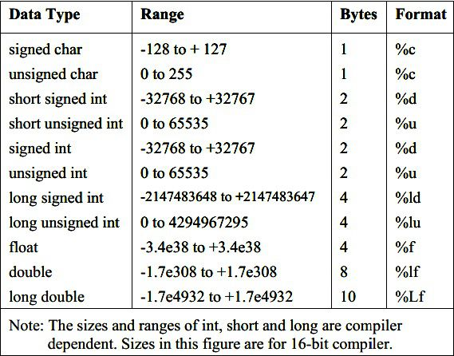
Size and Range of Data types on a 16-bit machine

Slide 3
Primary or Fundamental data types
Integers are whole numbers that can have both positive and negative values but no decimal values. Example: 0, -5, 10
In C programming, keyword int is used for declaring integer variable.
Floating type variables can hold real numbers such as: 2.34, -9.382, 5.0 etc.
You can declare a floating point variable in C by using either float or double keyword.

Slide 4
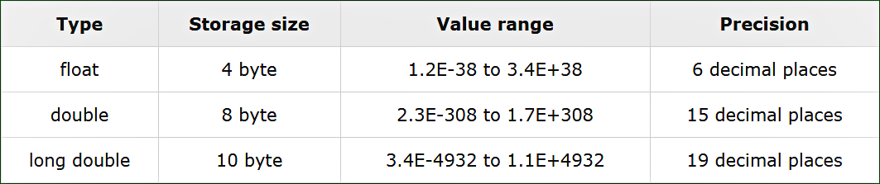
Difference among float, double and long double

Slide 5
void data type
The void type has no values.
This is usually used to specify the type of functions.
The type of a function is said to be void when it does not return any value to the calling function.
Examples: void main (), void main (void)

Slide 6
character data type
A single character can be defined as a character (char) type data.
Characters are usually stored in 8 bits (one byte) of internal storage.
The qualifier signed or unsigned may be explicitly applied to char.
unsigned char have values between 0 to 255
signed char have values from -128 to 127

Slide 7
C Qualifiers: Size Qualifiers
Size qualifiers alters the size of a basic type.
There are two size qualifiers, long and short.
For example: long double i;
The size of double is 8 bytes. However, when long keyword is used, that variable becomes 10 bytes.
There is another keyword short which can be used if you previously know the value of a variable will always be a small number.

Slide 8
C Qualifiers: Sign qualifiers
Integers and floating point variables can hold both negative and positive values.
However, if a variable needs to hold positive value only, unsigned data types are used.
There is another qualifier signed which can hold both negative and positive only. However, it is not necessary to define variable signed since a variable is signed by default.
An integer variable of 4 bytes can hold data from -2³¹ to 2³¹-1. However, if the variable is defined as unsigned, it can hold data from 0 to 2³²-1.

Slide 9
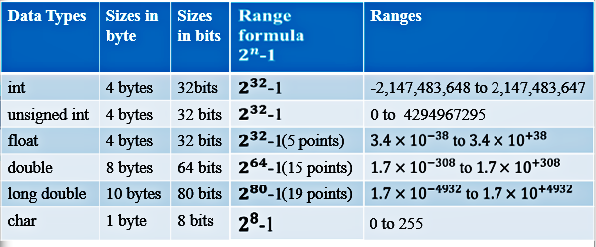
character data type

Slide 10
Declaration of Variables
After designing suitable variable names, we must declare them to the compiler.
Declaration does two things:
It tells the compiler what the variable name is.
It specifies what type of data the variable will hold.
The declaration of variables must be done before they are used in the program.

Slide 11
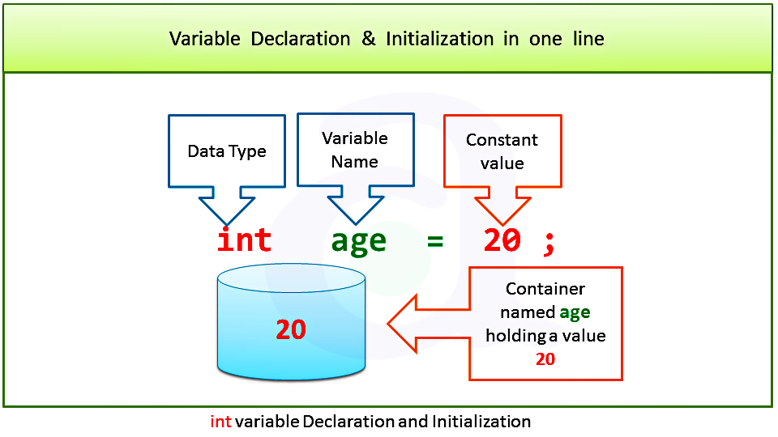
Declaration of Variables

Slide 12
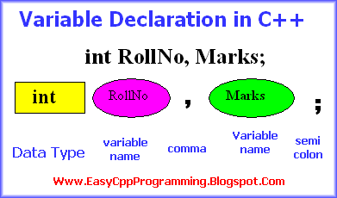
Declaration of Variables

Slide 13
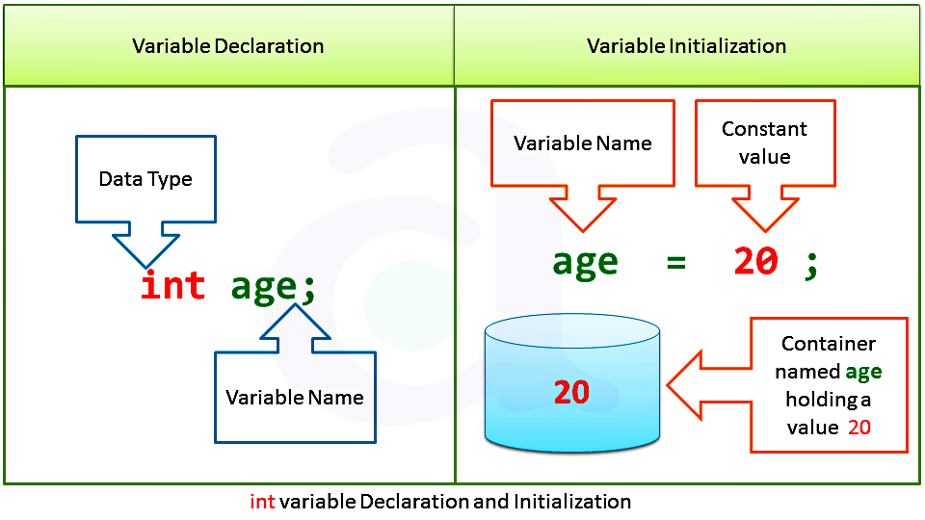
Declaration of Variables

