Slide 1
Assigning Values to Variables
Values can be assigned to variables using the assignment operator = as follows: variable_name = constant;
Further examples are:
initial_value = 0;
final_value = 100;
It is also possible to assign a value to a variable at the time variable is declared. This takes the following form:
data-type variable_name = constant;
int initial_value = 0;
int final_value = 0;

Slide 2
Multiple assignment
C permits the initialization of more than one variables in one statement using multiple assignment operators.
For example:
int column, row, index; column = index = row = 0;
int column = 0, row = 0, index = 0;
int column = 0; int row = 0; int index = 0;

Slide 3
Reading data from Keyboard: scanf function
We use the scanf() function to get input data from keyboard.
Format of scanf() function
scanf("control string", &variable1, &variable2, ...);
The control string holds the format of the data being received.
variable1, variable2, ... are the names of the variables that will hold the input value.
The & ampersand symbol is the address operator specifying the address of the variable where the input value will be stored.

Slide 4
#define statement
#define statement is a preprocessor compiler directive.
Symbolic names are sometimes called constant identifiers.
When a constant is used at many places in a program ,due to some reason if the value of that constant needs to be changed, then change at every statement where that constant occurs in the program –so modification of program becomes difficult. That is why #define statement is used.
Format:
#define symbolic_name constant
#define PI 3.1416

Slide 5
#define statement
#define statement is a preprocessor compiler directive.
Symbolic names are sometimes called constant identifiers.
When a constant is used at many places in a program ,due to some reason if the value of that constant needs to be changed, then change at every statement where that constant occurs in the program –so modification of program becomes difficult. That is why #define statement is used.
Format:
#define symbolic_name constant
#define PI 3.1416

Slide 6
#define statement
Symbolic names have the same form as variable names.
No blank space between the # sign and the word define is permitted.
# must be the first character in the line.
A blank space is required between #define and symbolic name and between the symbolic name and the constant.
#define statement must not end with a semicolon.
After definition, the symbolic name should not be assigned any other value within the program.
Symbolic names are not declared for data types.
#define statement may appear anywhere in the program (usual practice is to place them in the beginning of the program)

Slide 7
Program using #define statement
#include <stdio.h>
#include <math.h>
#define PI 3.142
void main()
{
float radius, area;
printf("Enter the radius of a circle \n");
scanf("%f", &radius);
area = PI * pow(radius, 2);
printf("Area of a circle = %5.2f\n", area);
}

Slide 8
Declaring a Variable as Constant
We may like the value of certain variable to remain constant during the execution of a program.
We can achieve this by declaring the variable with the qualifier const at the time of initialization.
For example: const int class_size = 40;
const is a new data type qualifier defined by ANSI standard.
This tells the compiler that the value of int variable class_size must not be modified by the program.

Slide 9
Declaring a Variable as Constant
// C program to demonstrate const specifier
#include <stdio.h>
int main()
{
const int num = 1;
num = 5; // Modifying the value
return 0;
}

Slide 10
Declaring a Variable as Volatile
ANSI standard defines another qualifier volatile that could be used to tell explicitly the compiler that a variables value may be changed at any time by some external sources.
For example: volatile int date
When we declare a variable as volatile, the compiler will examine the value of the variable each time it is encountered to see whether any external alteration has changed the value.

Slide 11
Overflow and Underflow of Data
Problem of data overflow occurs when the value of variable is either too big or too small for the data type to hold.
Assigning a value which is more than its upper limit is called overflow and less than its lower limit is called underflow.
Overflow normally results in the largest possible real value whereas an underflow results in zero.
C compiler does not provide any warning or indication of integer overflow. It simply gives incorrect result.

Slide 12
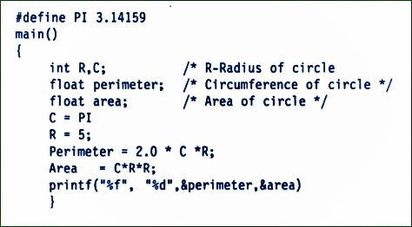
Identify syntax errors in the following program. After corrections, what output would you expect when you execute it?

