Slide 1
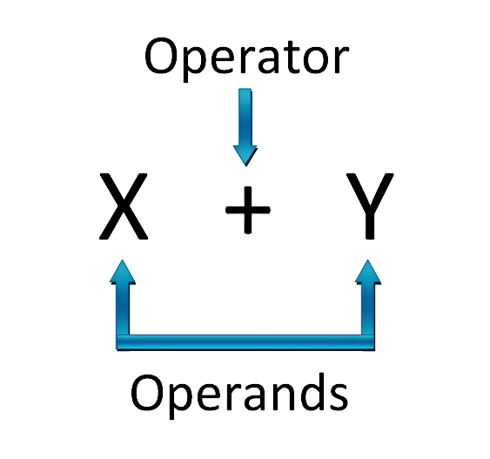
Chapter 3 Operator and Expressions

Slide 2
Operator
An operator is a symbol that tells the compiler to perform certain mathematical or logical manipulations.
C operator can be classified into a number of categories:
Arithmetic Operator
Relational Operator
Logical Operator
Assignment Operator
Increment and decrement Operator
Conditional Operator
Bitwise Operator
Special Operator

Slide 3
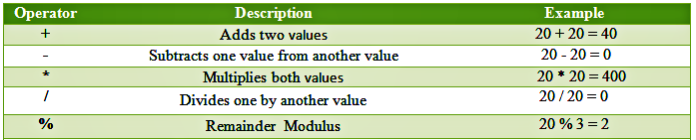
Arithmetic Operator
These are used to perform mathematical calculations like addition, subtraction, multiplication, division and modulus.

Slide 4
Program 3.1 (Text Book = 53)
#include<stdio.h>
void main ()
{
int months, days ;
printf("Enter days\n") ;
scanf("%d", &days) ;
months = days / 30 ;
days = days % 30 ;
printf("Months = %d Days = %d", months, days) ;
}
Output:
Enter days
265
Months = 8 Days = 25
Enter days
364
Months = 12 Days = 4
Enter days
45
Months = 1 Days = 15

Slide 5
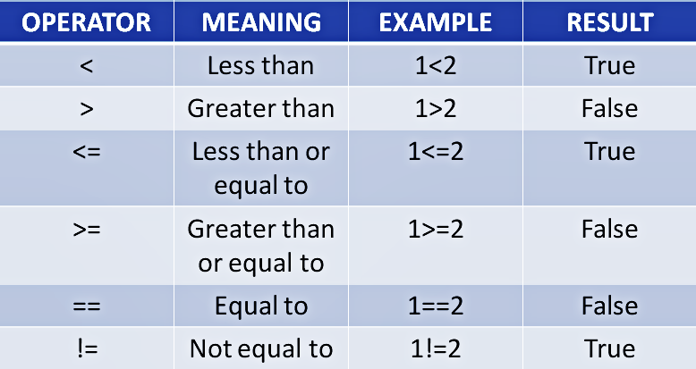
Relational Operator
These operators are used to compare the value of two variables.
The value of relational operator is either one or zero.
It is one if the specified relation is true and zero if the relation is false.

Slide 6
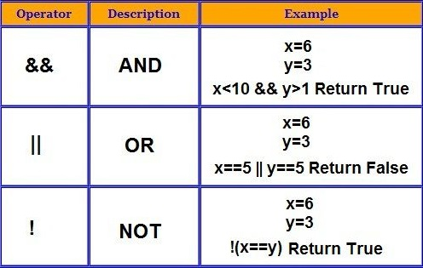
Logical Operator
Logical operator combines two or more relational expressions.
Logical expressions yields a value of one or zero according to true or false.

Slide 7
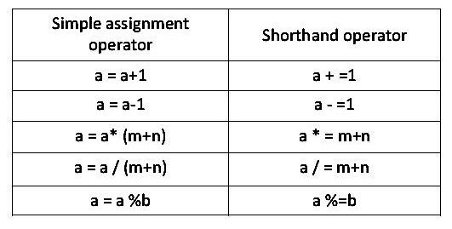
Assignment Operator
These are used to assign the values for the variables in C programs.
C also has a set of shorthand assignment operators.

Slide 8
Shorthand Assignment Operator
What appears on the left-hand side need not to be repeated and therefore it becomes easier to write.
The statement is more concise and easier to read.
The statement is more efficient.

Slide 9
Increment and Decrement Operator
Increment operator is denoted by ++ and decrement operator is denoted by --
The operator ++ adds 1 to the operand, while – subtracts 1.
Format: ++m ; m++ ; --m ; m—
If increment or decrement operator is used before variable, it is called prefix notation.
If increment or decrement operator is used after variable, it is called postfix notation.

Slide 10
Difference between Prefix and Postfix notation
In case of prefix notation, compiler add or subtract 1 with the initial value of variable and the new value of variable is used in the same statement.
In case of postfix notation, compiler add or subtract 1 with the initial value of variable and the new value of variable is used in the next statement.
Suppose, a = 5 then,
++a; //a becomes 6
a++; //a becomes 7
--a; //a becomes 6
a--; //a becomes 5

Slide 11
Program: Difference between Prefix and Postfix notation
void main ()
{ int i;
i=0;
printf(“the number is %d”, i);
printf(“the number is %d”, ++i);
printf(“the number is %d”, i);
i=0;
printf(“the number is %d”, i);
printf(“the number is %d”, i++);
printf(“the number is %d”, i); }
Output:
the number is 0
the number is 1
the number is 1
the number is 0
the number is 0
the number is 1

