Slide 1
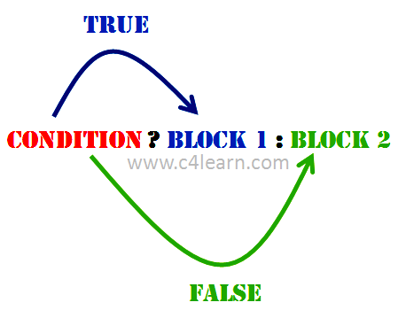
Conditional Operator

Slide 2
Conditional Operator
Format: expression1 ? expression2 : expression3
Expression 1 is evaluated first
If expression1 is true, then expression2 is evaluated and its value becomes the value of the expression.
If expression1 is false, expression3 is evaluated and its value becomes the value of the expression.
Note that, only one of the expressions (either expression2 or expression3 is evaluated)

Slide 3
Code: Conditional Operator
float a,b,c,d,z,average;
printf("enter the value of four class tests respectively =\n");
scanf("%f%f%f%f",&a,&b,&c,&d);
z=(a<b)?a:b;
z=(z<c)?z:c;
z=(z<d)?z:d;
average=(a+b+c+d-z)/3.0;
printf("\nAverage of best of three classtest is: %f",average);

Slide 4
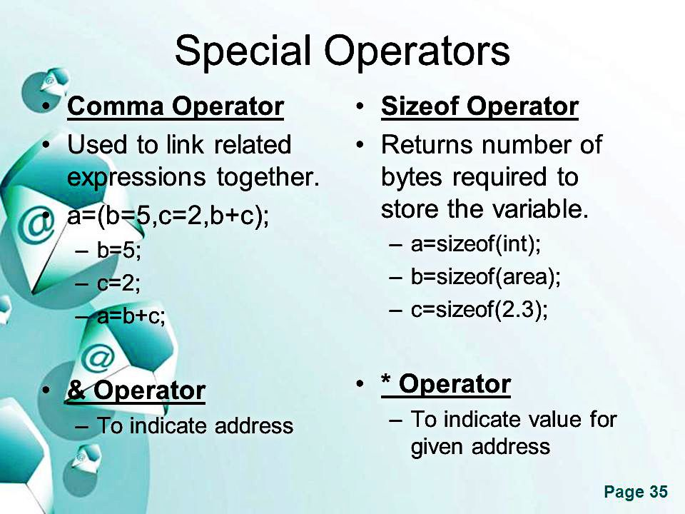

Slide 5
Special Operator: Comma Operator
The comma operator can be used to link the related expressions together.
A comma-linked list of expressions are evaluated left to right and the value of right-most expression is the value of the combined expression.
For example: value=(x=10,y=5,x+y);

Slide 6
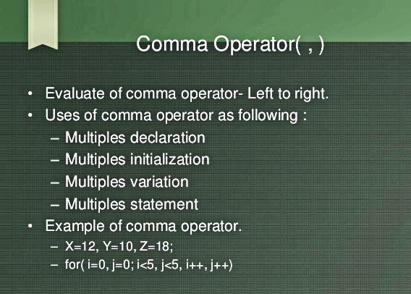

Slide 7
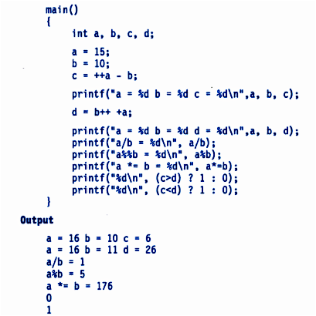
Program 3.3 (Text Book = 62)

Slide 8
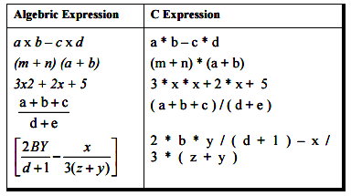
Arithmetic Expression to C Expression

Slide 9
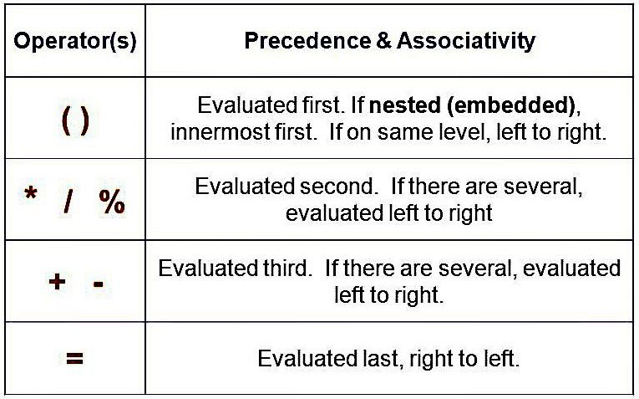
Precedence of Arithmetic Operators

Slide 10
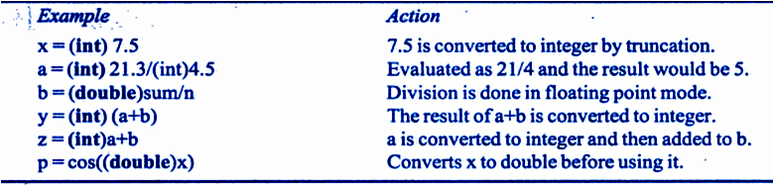
Cast Operator
To change data type temporarily, cast operator is used.
Format: (conversion type)variable name

Slide 11
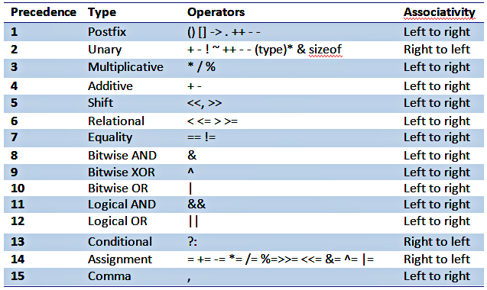

Slide 12
Operator Precedence and Associativity
Consider the statement: if(x==10+15 && y<10) for x = 20 and y = 5
Addition operator has a higher priority than logical operator and the relational operators.
Therefore addition of 10 and 15 is executed first.
Statement becomes: if(x==25 && y<10)
Next step: x==5 is false(0) ; y<10 is true(1)
Operator < enjoys a higher priority compared to ==, y<10 is tested first and then x==25 is tested.
Finally we get: if(false && true)
Because one of the conditions is false, the complex condition is false.
In case of &&, second operand will not be evaluated if the first is zero
In case of ||, second operand will not be evaluated if the first is non-zero.

Slide 13
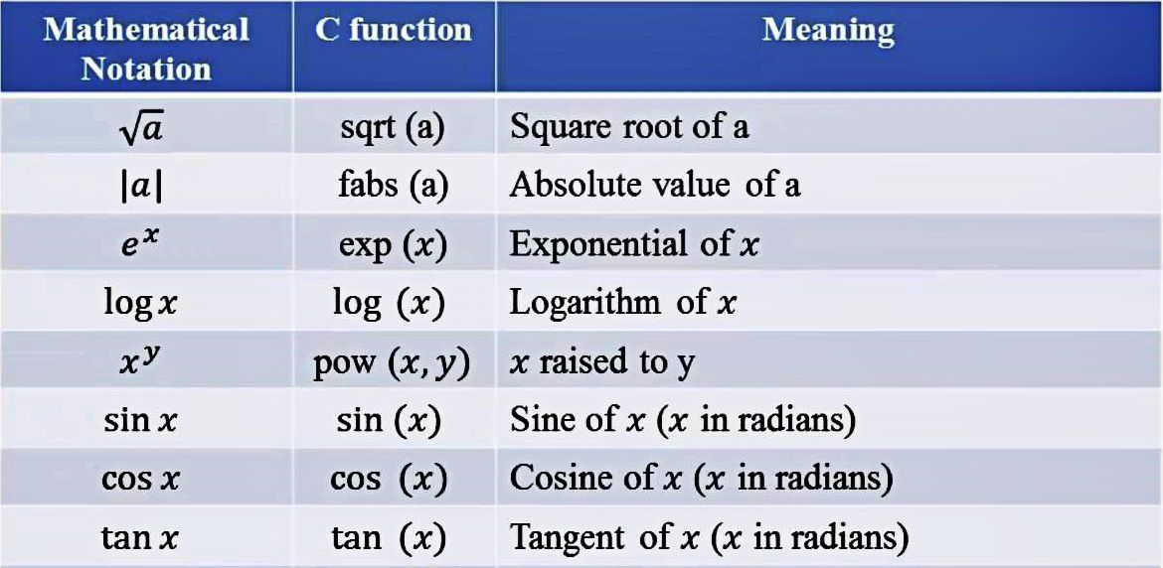
Mathematical Functions (Text Book = 73)

Slide 14
Assignments
Just Remember
Case Studies
1. A program to compute a sales-persons gross salary
2. Solution of Quadratic Equation
Review Questions [3.1 to 3.20]
Programming Exercises [3.1 to 3.20]

