Slide 1

CHAPTER 5
DECISION MAKING AND BRANCHING

Slide 2
Introduction
C language possesses decision making capabilities by supporting following statements:
If statement
switch statement
Conditional operator statement
goto statement

Slide 3
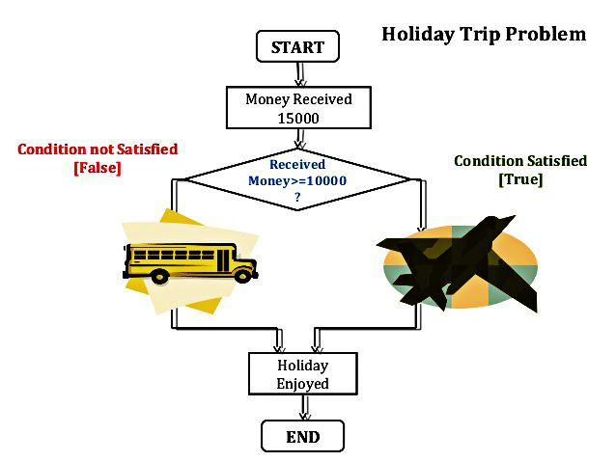
DECISION MAKING AND BRANCHING

Slide 4
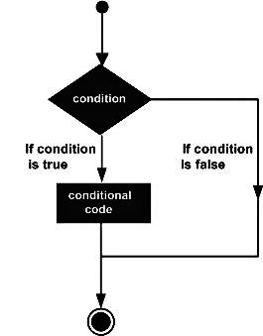
Decision making with if statement

Slide 5
Decision making with if statement
Format: if(test expression)
It is basically a two-way statement and is used in conjunction with an expression.
It allows the computer to evaluate the expression first and then, depending on whether the value of the expression (relation or condition) is true or false, it transfer the control to a particular statement.
This point of program has two paths to follow:
One for the true condition and
The other for the false condition.

Slide 6
Different forms of if statement
Simple if statement
if……………else statement
Nested if…………….else statement
Else if ladder

Slide 7
Simple if statement
General form of a simple if statement
if(test expression)
{
statement-block;
}
statement-x;

Slide 8
Simple if statement
The statement-block may be a single statement or a group of statements.
If the test expression is true, the statement-block will be executed; otherwise the statement block will be skipped and the execution will jump to the statement-x.
Remember, when the condition is true, both the statement block and the statement-x are executed in sequence.

Slide 9
Simple if statement
{ int a, b, c, d;
float ratio;
printf("Enter four integer values\n");
scanf("%d %d %d %d", &a, &b, &c, &d);
if (c-d!= 0) /* Execute statement block */
{
ratio = (float)(a+b)/(float)(c-d);
printf("Ratio = %f\n", ratio);
}
}

Slide 10
if………else statement
General format:
if(test expression)
{
True-block statement;
}
else
{
False-block statement;
}
Statement-x

Slide 11
if………else statement
If the test expression is true, then the true-block statement, immediately following the if statements are executed; otherwise, the false-block statement are executed.
In either case, either true-block or false block will be executed.

Slide 12
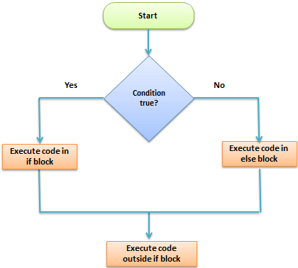
if………else statement

Slide 13
if………else statement
{
int number;
printf("Enter an integer: ");
scanf("%d",&number);
if( number%2 == 0 )
{printf("%d is an even integer",number);}
else
{printf("%d is an odd integer",number);}
return 0;
}

Slide 14
Nesting of if…….else statements
if (test condition-1)
{
if (test condition-2)
{ statement-1; }
else
{ statement-2; }
}
else
{statement-3;}
statement-x

Slide 15
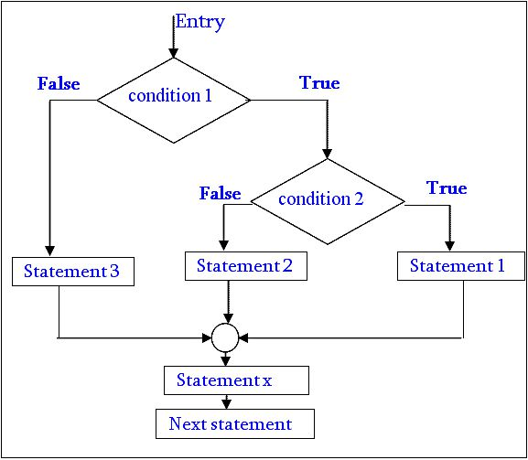

Slide 16
Nesting of if…….else statements
If condition-1 is false, statement 3 will be executed, otherwise it continues to perform the second test.
If condition-2 is true, the statement-1 will be executed; otherwise statement-2 will be evaluated and the control is transferred to the statement-x

Slide 17
C program to find the largest of three numbers
{
double n1, n2, n3;
printf("Enter three numbers: ");
scanf("%lf %lf %lf", &n1, &n2, &n3);
if (n1>=n2)
{
if(n1>=n3)
{printf("%.2lf is the largest number.", n1);}
else
{printf("%.2lf is the largest number.", n3);}
}
else
{
if(n2>=n3)
{printf("%.2lf is the largest number.", n2);}
else
{printf("%.2lf is the largest number.",n3);}
}
return 0;
}

