Slide 1
PRESENTATION ON
BRIDGES
SUBMITTED BY:
ROLL: 130011-130020

Slide 2
        CONTENTS:
          DEFINITIONS
          COMPONENTS OF BRIDGES
          CONSTRUCTION METHODS FOR BRIDGE
          BRIDGE MATERIALS & CONSTRAINTS BUILDING MATERIALS
          LOADS,AXIAL LOADS & FORCES & EQUILIBRIUM STATE
          TYPES OF BRIDGES
          TRUSS BRIDGES,TRUSS FORCE ANALYSIS,BEAM,ARCH BRIDGES,FUNCTION,SUSPENSION BRIDGE,SUSPENSION,CANTILIVER BRIDGE
          EFFECT OF TEMPERATURE

Slide 3
INTRODUCTION…………………
A bridge is a structure built to across a obstacles such as a body of water, valley, or road, for the purpose of providing passage over the obstacle.
Designs of bridges depending on the function of the bridge, length of the bridge, span of the bridge, the nature of the terrain, and the material used to make it

Slide 4
COMPONENTS OF BRIDGES……..
Superstructure or Bridge deck – the horizontal part of a bridge that support pedestrian or traffic activities.
Bearings - Superstructure or Bridge deck – the horizontal part of a bridge that support pedestrian or traffic activities.
transmit the load received from the decking on to the substructure.
Substructure –
  Piers or Abutments- Vertical member support the deck or bearing.
  Foundation – Transmits the load of Superstructure, Piers or Abutments evenly distribute the load on to the strata

Slide 5
BRIDGES!!!!!!!!...................
Bridge Material
  Timber
  Concrete
  Steel

Slide 6
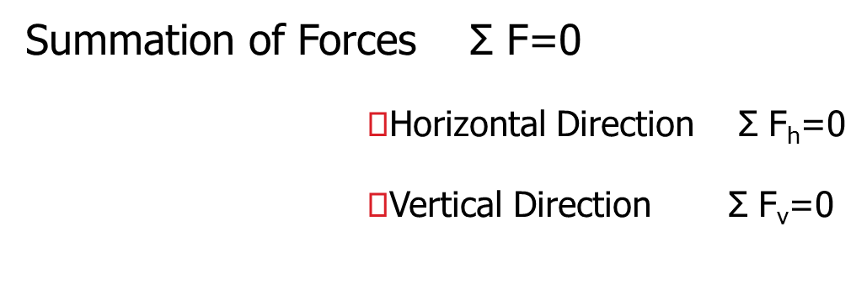
EQUILIBRIUM STATE……….
LOADS
FORCES
MOMENTS
TORSION

Slide 7

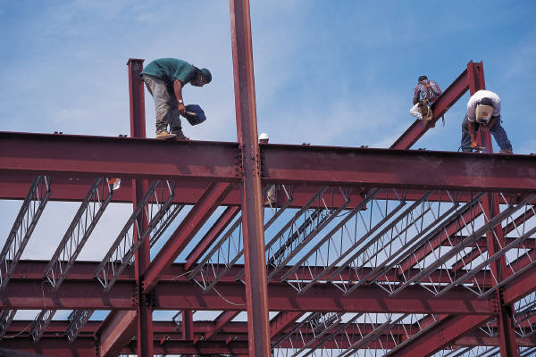


LOADS……………………………
Dead Loads
Live Loads
Wind Loads
Snow Loads
Earthquake Loads

Slide 8
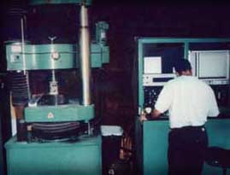
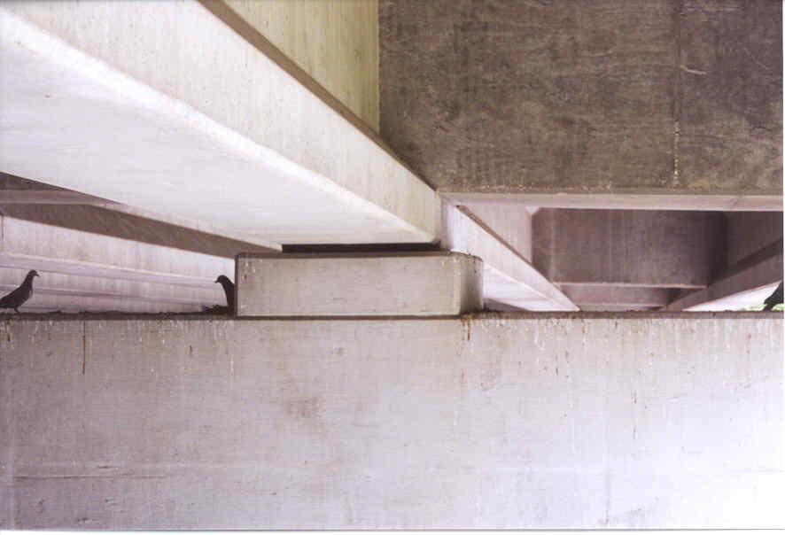
AXIAL LOADS & FORCES………..
Compression
  pushing or
  shortening
Tension
  pulling or
  elongating

Slide 9
CONSTRUCTION METHODS………
1. Cast-in-Situ Method :
This Method Prefer for Short Bridges. Time consuming is large in cast-in-situ construction as it involves following steps.
  Erection on ground supported staging
  Casting of concrete
  Dismantling of staging

Slide 10
2.Precast segmental methods…..
This method is used for the long bridges. It is economical when there is large no of span. This method involves the following steps.
Casting of Precast segments in casting yard.
Transporting the precast segments at the site.
Erection of the precast segment using launcher or crane.
External Prestressing.
Grouting.

Slide 11
Types of bridges…………
Bridge Type
  Truss Bridge
  Arch bridge
  Suspension Bridge
  Cantilever Bridge

Slide 12
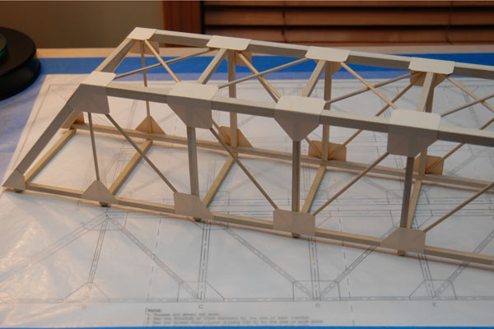
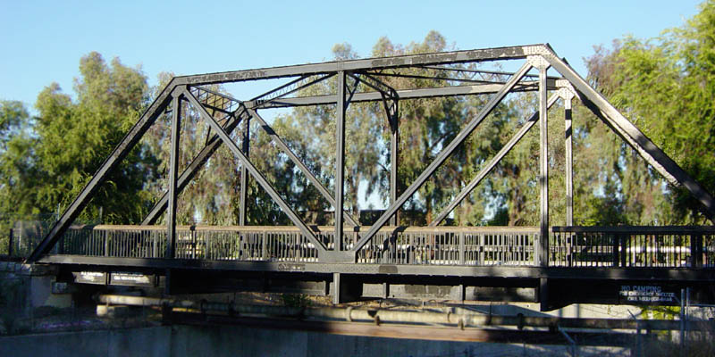
TRUSS BRIDGES……………………..
Truss design is to support the bridge deck
The truss may have compression or tension
The joint of truss is important

Slide 13
Truss(force analysis)……..
Loads members in tension and compression.
Members are pinned at joints (Moment = 0).
Triangles provide stability and strength.
Top members in Compression.
Bottom members in Tension.
Hint - Imagine entire truss wrapped in rubber skin, so you have a large rubber box. When you bend it, where would the wrinkles be? They indicate compression.

Slide 14
Beam bridge….
vs.
Ways to strengthen members in bending.
  Decrease overall length (deflections).
  Cross section design (moment of inertia)
  Use stronger materials (elastic modulus).
Compression
=
Axis of bending
Tension
Steel

Slide 15
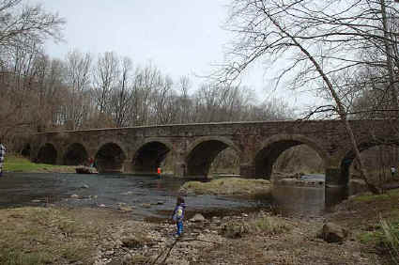
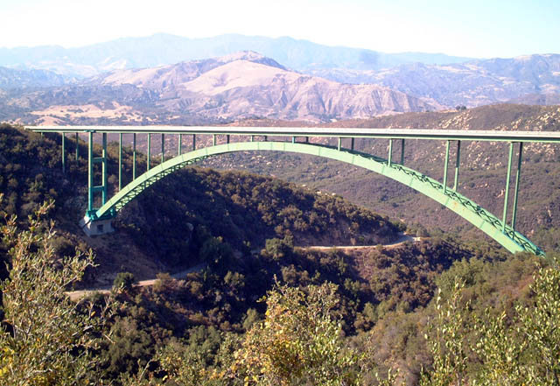
Arch bridge ……….
Appear mostly in Ancient time
New arch bridge is modified to reduce the material

Slide 16
Function of arch structure……….
Puts members in compression.
Need horizontal support at abutments.
Abutment
Arch reduce the bending on the member !

Slide 17
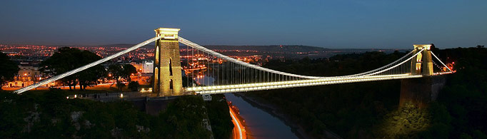
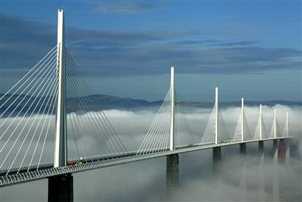
Suspension Bridge……..
Replace the Beam with cable
Reduce the need for the Pier , Girder and Truss

Slide 18
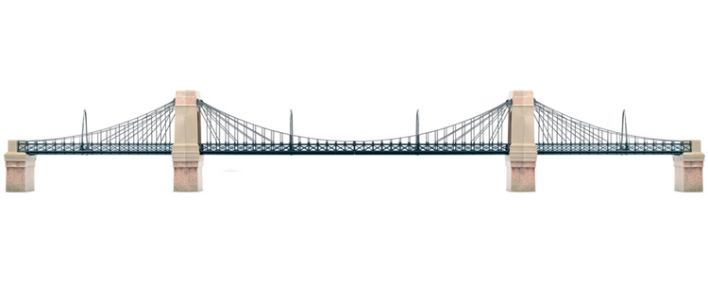
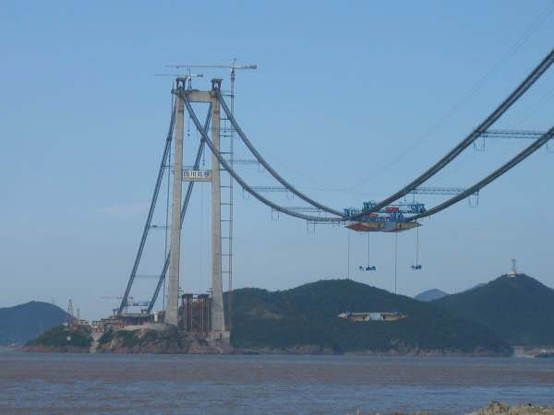
Suspension……………..
Suspension……………..
Puts members in tension.
Carries weight up to the top of the towers.
Good for long spans.

Slide 19
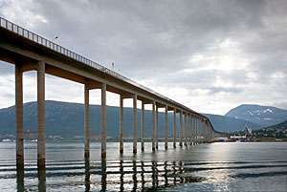

CANTILIVER BRIDGES……….
No support at the bridge itself
Material must be strong
Or the structure must be different

Slide 20
EFFECT OF TEMPERATURE….
The effect of temperature change on bridge structural behaviour can be significant .
The structural response associated with a change in temperature over the course of a year can be of the same magnitude as the structural response caused by live load.
Changes in temperature may have a variety of effects on a single structural element depending on the element support condition.
If a simply beam is subjected to a uniform change in temperature, the change will cause either elongation or shortening
If a constraints element is subjected to change in temperature significant stress may build up in the element.
A member that is neither fully free nor fully fixed & its end will elongate or contract.

Slide 21
Thanks for co-operating

