Slide 1
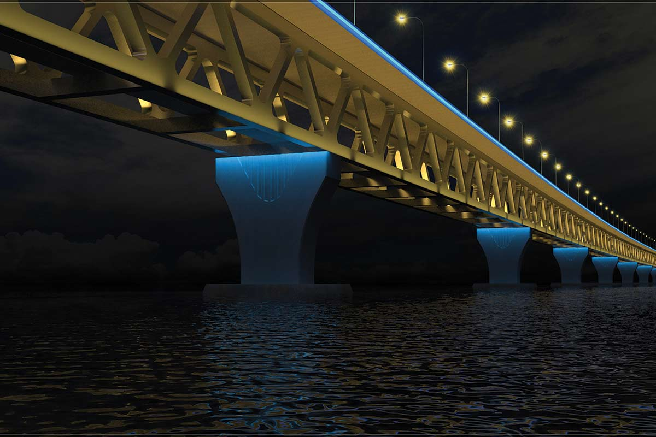
PRESENTATION ON
PADMA MULTIPURPOSE BRIDGE
Group no-03
Group members-
130021
130022
130023
130024
130026
130027
130028
130029
130030
Welcome to our presentation on the structure of padma multipurpose bridge
Group no -03
Group members-
130021
130022
130023
130024
130026
130037
130028
130029
130030

Slide 2
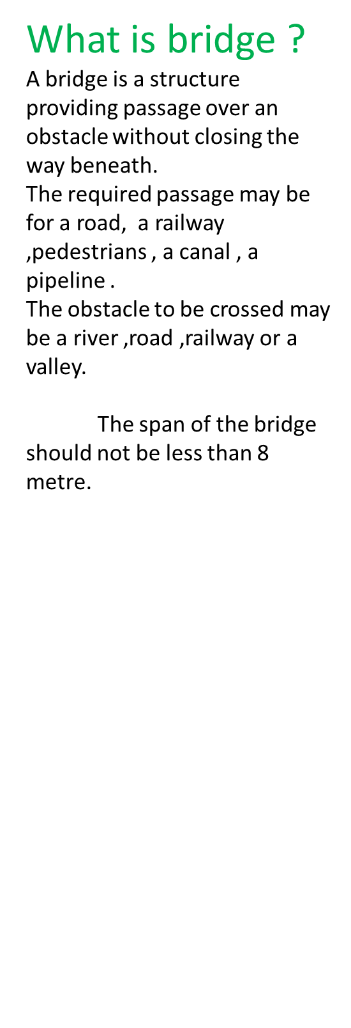
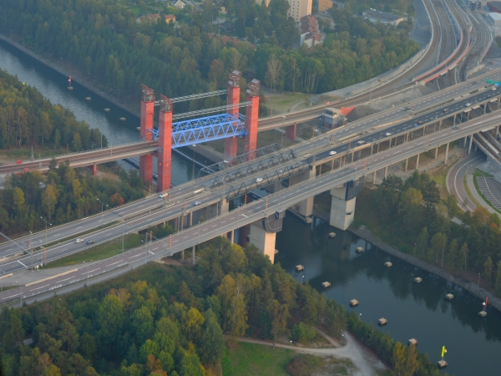

Slide 3
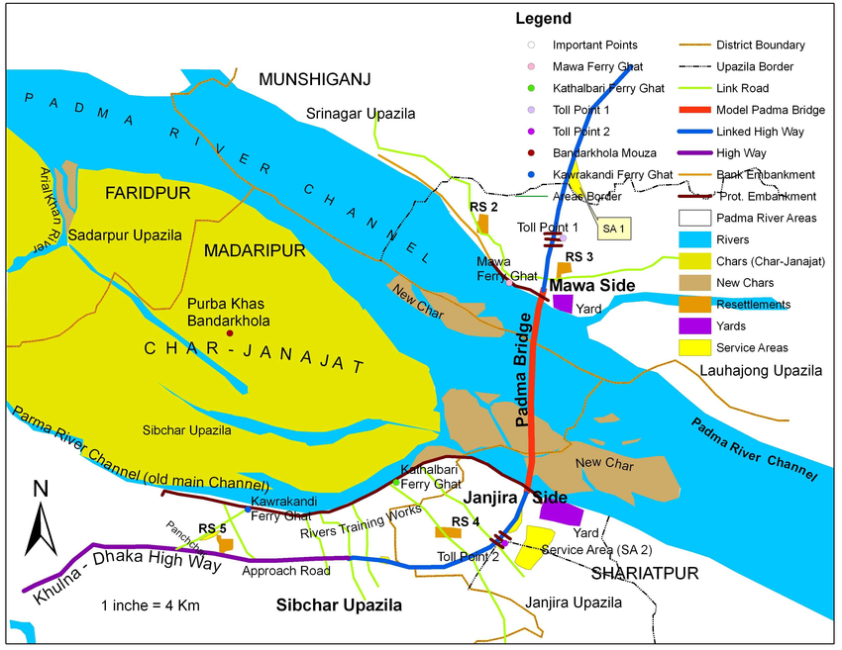
Padma multipurpose bridge
=>It is the largest bridge in our country.
=>It connects mawa point at north bank with
Janjira of southern bank.
=>It will connect Louhajong ,Munshigonj to Shariatpur and Madaripur,linking the south-west of the country to northern and eastern
Regions.
=>918 hectors land is being used for this project
It will be 2nd largest discharge design in the world.
It is designed for 100 years of 1,40000 m3/sec of flooding discharge.

Slide 4
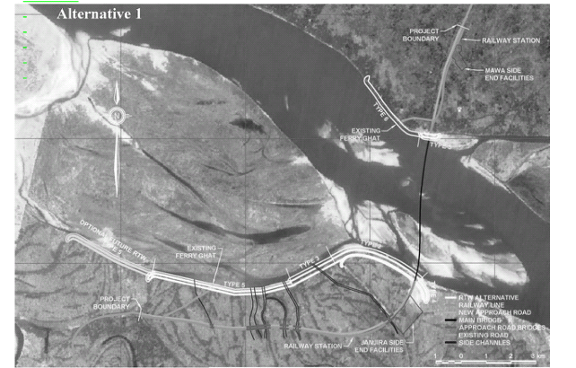
River training work
The river training works(RTW) are intended to protect the main bridge,vaiducts, end faicilities and the new approach roads.
By SPT test it was observed that there is sandy soil in janjira points, so for scouring characteristics of soil the river training was done for 10.5 Km.
In Mawa point there is clayey property of soil. So river training was done for only 1.5 Km.
River training was done by providing geotextile bags.

Slide 5
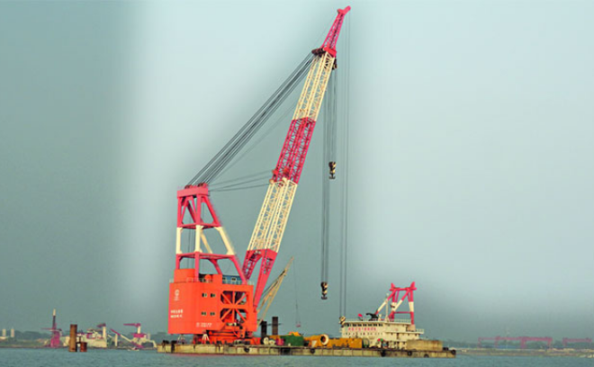
Sent compaction pile Machine
In Janjira points there is soft soils.So if road is constructed without compaction,there is a possibility of settlement of connection road with bridge.
Then connection with bridge may hampered.
In order to prevent settlement the compaction work was done in this points.
So compaction was done for increasing density of soil.This was done by sent compaction pile machine. This machine was brought from Germany.
In this system a pipe was penetrated through soft soil and a vertical pressure was given at the top of pipe and the bottom portion of the pipe was kept closed.
In this process soil was compacted.

Slide 6
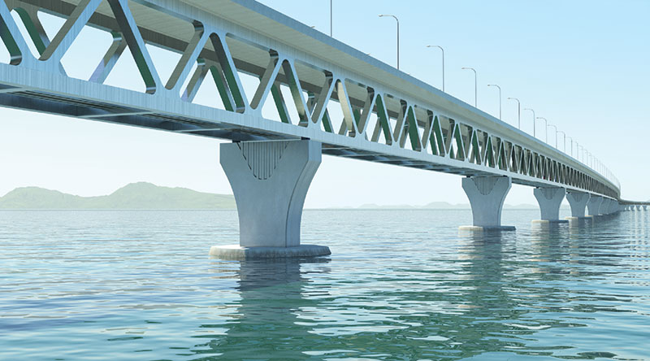
Superstructure
Upper deck:22 m wide concrete deck slab(4 lane).Prestressed concrete box girder is used.
Lower deck:(single track dual gauge rail).
Deck height:13.6 m
Navigational clearance:18.30 m
Total length: 6150 m
Number of span:
41(each span 150 m)
Upper deck
Lower deck
pier
Triangular truss

Slide 7
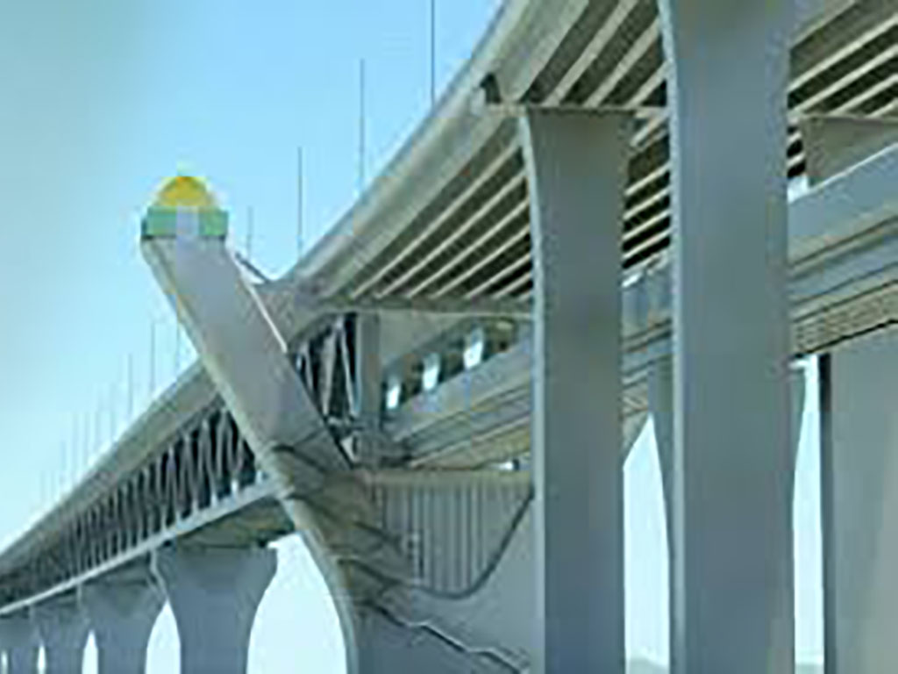
PIER
There are 2 transition pier at landward ends.
40 center piers.
Transition pier
Centre pier

Slide 8
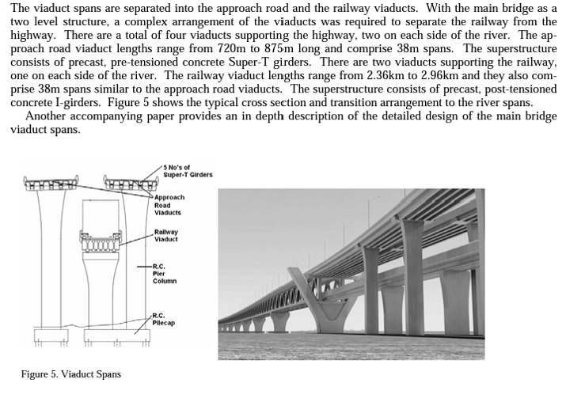
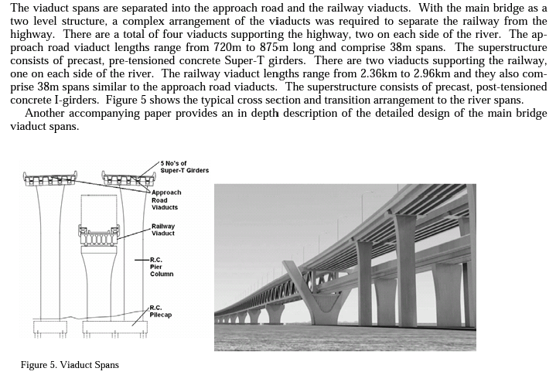
Viaduct Spans

Slide 9
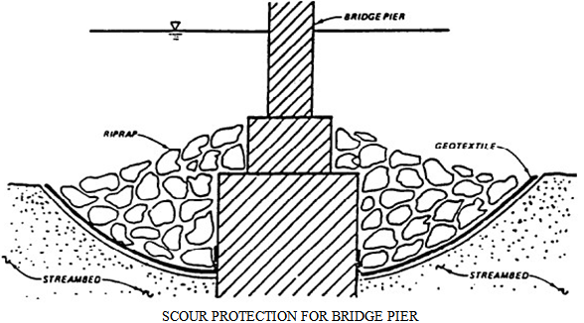
Construction details of substructure
geotextile bag:
Due to large scouring characterstics of the padma river,protections are needed at both Mawa and janjira points.
To protect the bank of river which is connected on both sides with bridge this gravel or geotextile bags are provided by drazing100 ft under ground level.
This bag is made of synthetic rubber and that can pass water and filled with sand.
Each of the bag is weighted 800 Kg .
It protects the road which is connected with bridge.

Slide 10
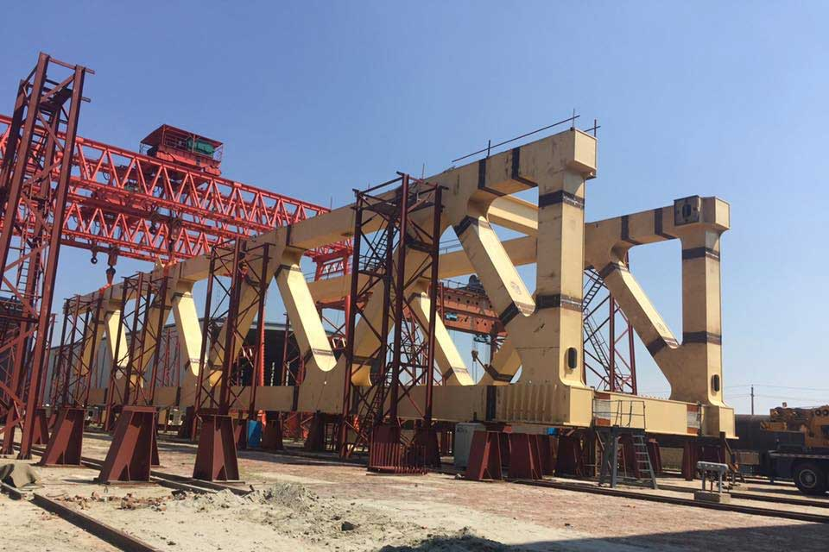
Truss
The lower deck of Padma bridge is railway and it is of steel structure.The triangular truss supports railway.
The upper deck of the bridge is of concrete structure and it is roadway.
The railway is designed in such a manner that it can carry 2 container rail.

Slide 11
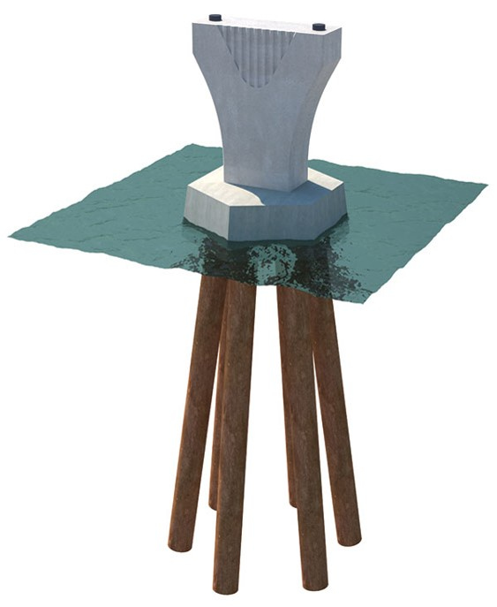
PILE DETAILS
1. Racked (inclined at 1H:6V) ;steel tabular driven pile
2. 6 nos in each pier.
3. Pile diameter 3 metre
4. Pile length 128 m
128m piles are used but in inverted “v” shape.
In America and other coastal areas during storm attack people used to stand like inverted V shape to reduce wind effect.
On the basis of this concept piles are constructed like inverted v shape to reduce wind and velocity effect(reduce 20% cost).

Slide 12
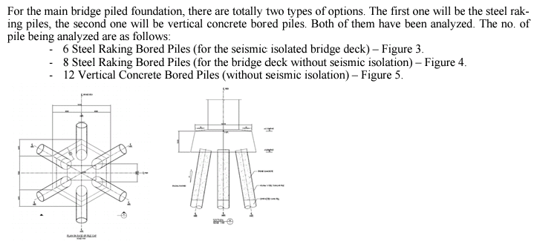
Pile arrangement
Figure 3:pile arrangement of padma bridge.

Slide 13
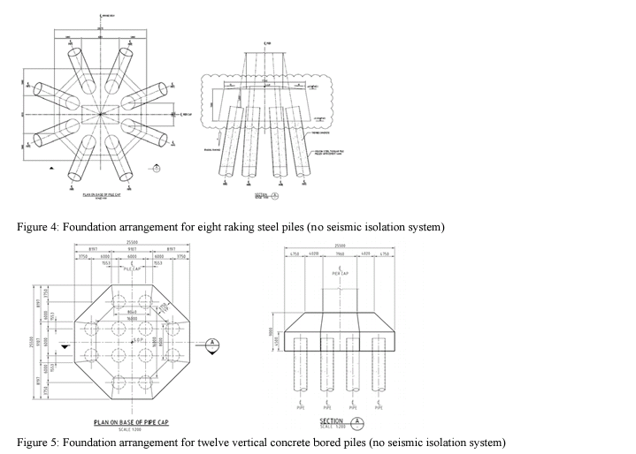

Slide 14
Structural design of pile
This main bridge behaves in complicated manners due to its height and large mass of superstructure, pile cap and pile
To carry out its design a 3D nonlinear time history dynamic analysis, using a modified penzien model has been adopted .
The model has two parts i)structure
ii)free field soil
The interaction between the structure and free field are simulated by
spring links.
To determine the equivalent shear modulus and effective damping ratio between each layer of soil free field analysis has been carried out by program SHAKE.
Subsequently a 3D dynamic analysis has been carried out using the equivalent shear modulus and effective damping as input data.

Slide 15
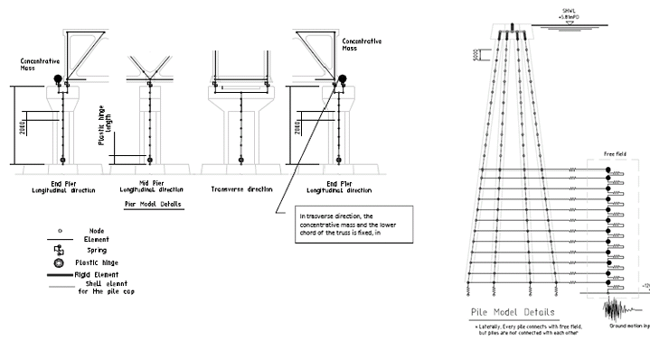

Slide 16
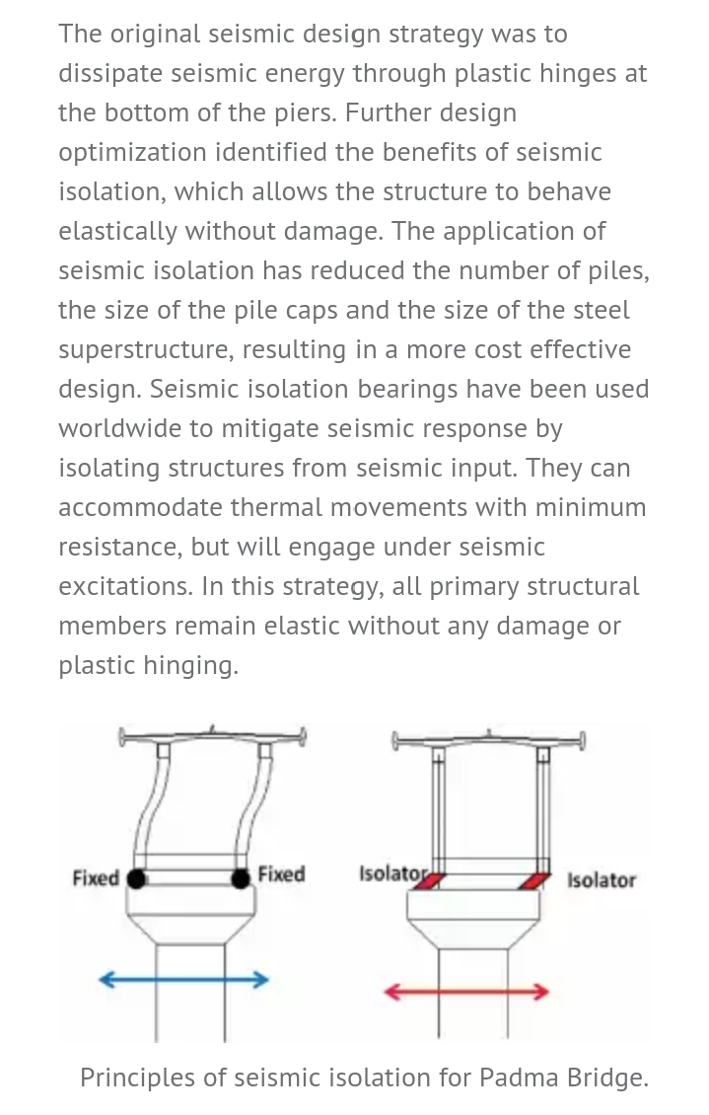

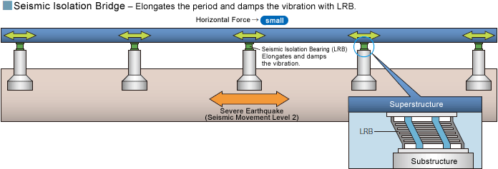
PENDULUMN BEARING

Slide 17
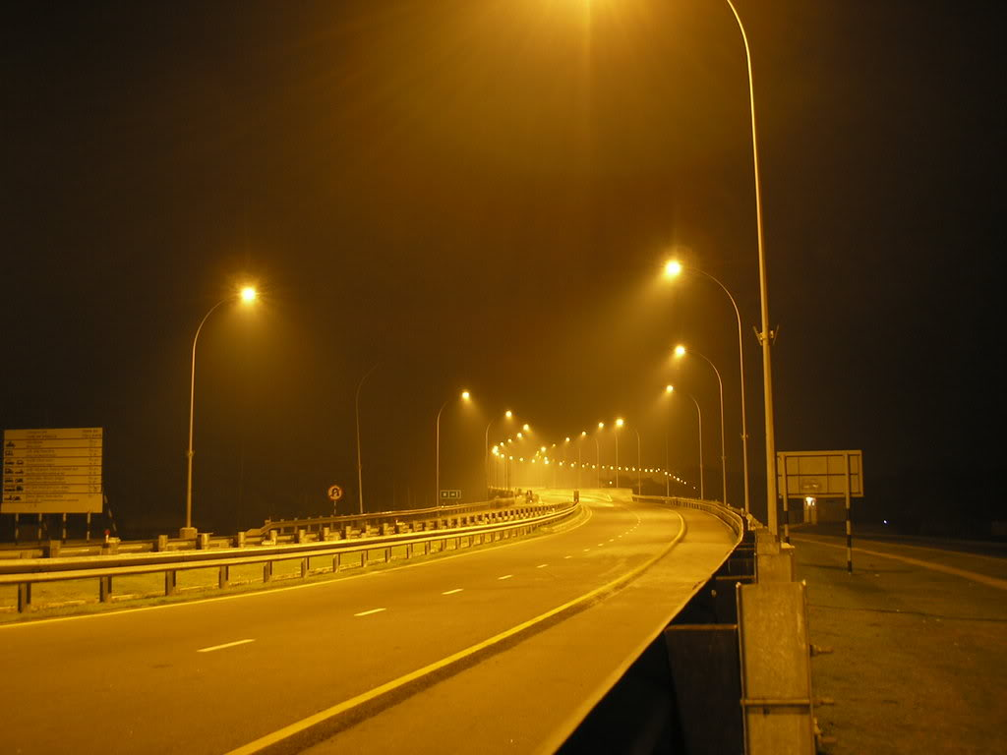
THANK YOU FOR YOUR PATIENCE HEARING

