Slide 1
EFFECTS OF IMPACT LOAD AND CONSTRUCTON METHODS OF BRIDGE
GROUP: A-04
ROLL: 130031-13040

Slide 2
our presentation is in two segments
1st one : effects of various types of impact load on bridge
2nd one : various types of construction methods all over the world

Slide 3
Effects of various types of impact load on bridge
Impact load:
The dynamic effect on a structure, either moving or at rest, of a forcible momentary contact of another moving body in a short time.
types of Impact load on bridge:
earthquake
wind effect
live load

Slide 4
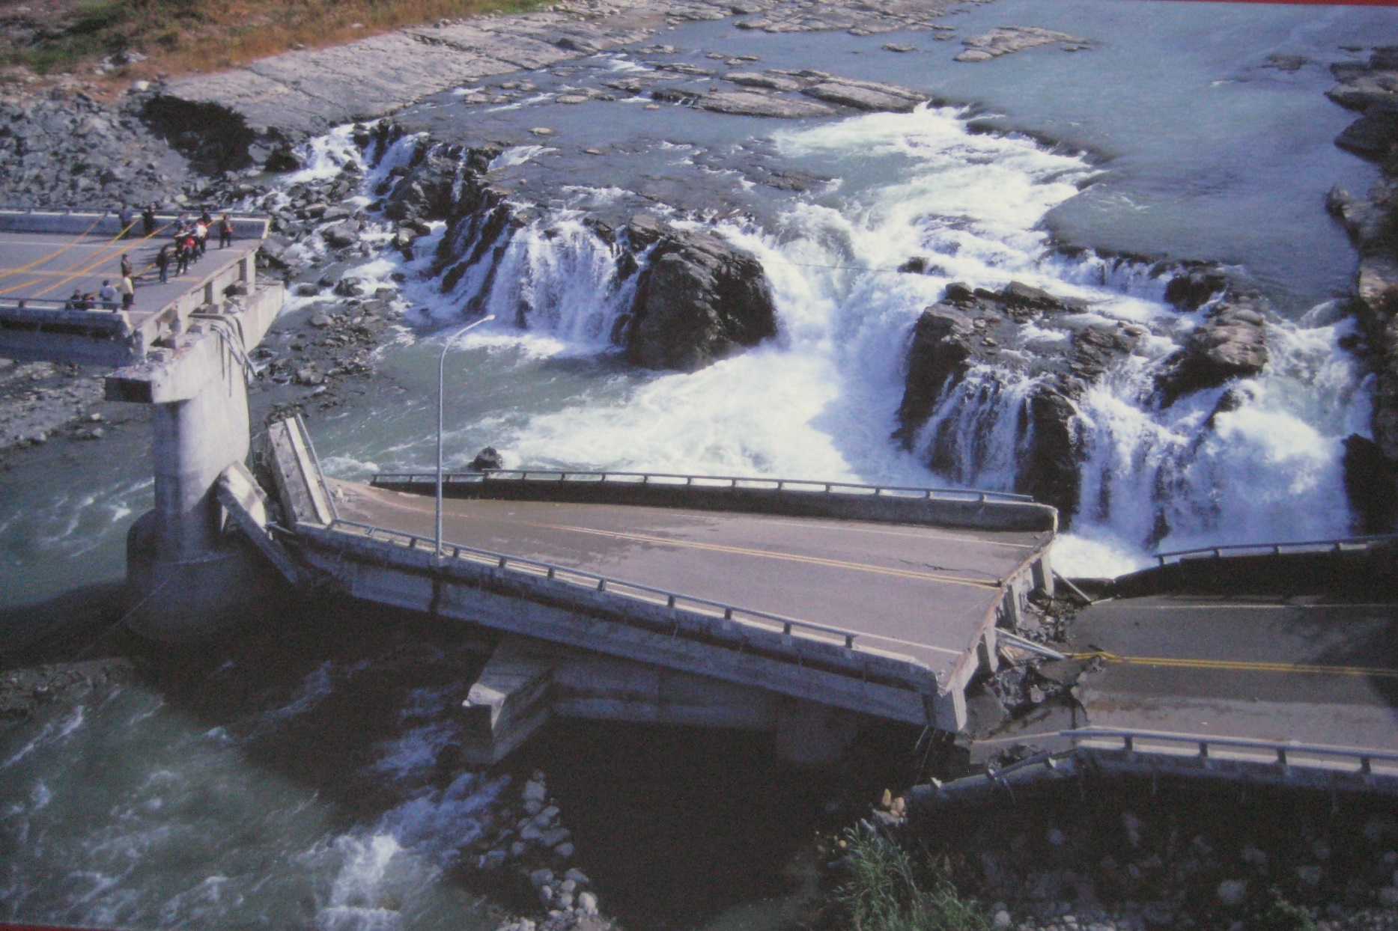
How do earthquakes affect on bridges

Slide 5
In the last few years in the Indian subcontinent, we have been experiencing a significant increase in the frequency and magnitude of earthquakes.
There are many who say that this is the result of the exploration for underground gas reserves, which has become widespread in this area.
No matter the root cause, the subject of how earthquakes affect bridges is now on the minds of many.

Slide 6
When evaluating the affects of earthquakes the most important factors to take into account are the magnitude of the earthquake, the distance from the epicenter of the earthquake and the geologic conditions at the site of the earthquake itself.
When it comes to how earthquakes can affect bridges, the main concern is the damage that can be caused by the ground motion that the earthquake creates.

Slide 7
When soft soil lies on top of hard bedrock the ground motion is amplified, this is known as ground-motion amplification.
This type of amplification can result in much greater damage, even from bridges that are quit a distance from the epicenter of the earthquake itself.
In fact, soft sandy soils can actually be liquefied by strong ground motion in a process call liquefaction.

Slide 8
When liquefaction occurs, the foundation of structures, like bridges, can be completely compromised.
Whether Earthquakes Affect Bridges Depends Greatly On the Magnitude.
The general rule of thumb is that earthquakes below a magnitude of 4.0 do not cause infrastructure damage.
Highway engineers have devised standards in an attempt to earthquake-proof bridges that have been built since the early 1990's.

Slide 9
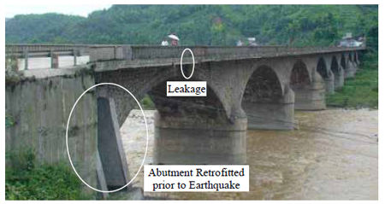
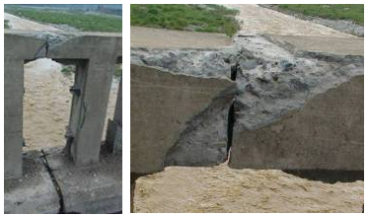
Overview Pounding Damage at Railing Joints
TONGJI BRIDGE, CHINA

Slide 10
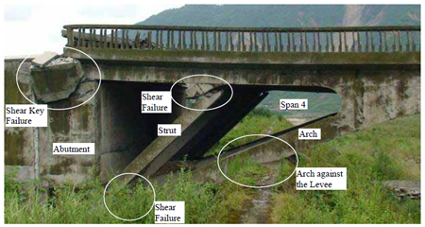
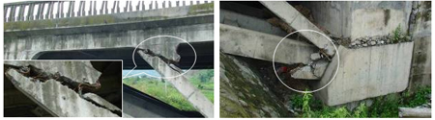
Damage in Easternmost Details of Shear Failures
Span
XIAOYUDONG BRIDGE, CHINA

Slide 11
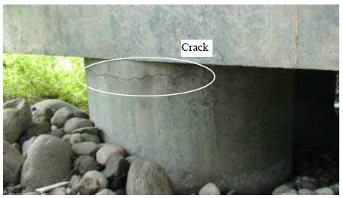
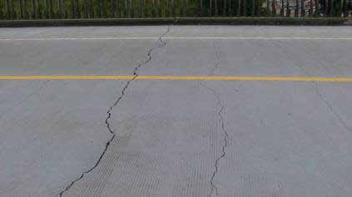
Flexural Crack on Pile Shaft Transverse Crack on Top of the Bridge Deck
XIAOYUDONG BRIDGE, CHINA

Slide 12
Wind Effect On BRIDGE
Wind produces 3 types of effects on structure. They are :
Static
Dynamic
Aerodynamic
When the structure deflects in response to wind load then the dynamic and aerodynamic effects should be analysed in addition to static effect.actually wind creat aerodymanic effect on bridge as impact load.

Slide 13
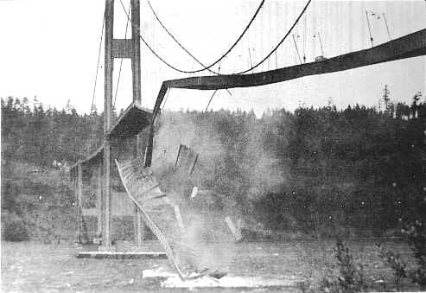
Bridge aerodynamics and wind induced vibrations:
1.Galloping: Galloping is transverse oscillation of some structures due to the development of aerodynamic forces. Non circular cross section are more susceptible to this type of oscillation.
Tacoma Narrows Bridge, Washington
Figure : Galloping effect

Slide 14
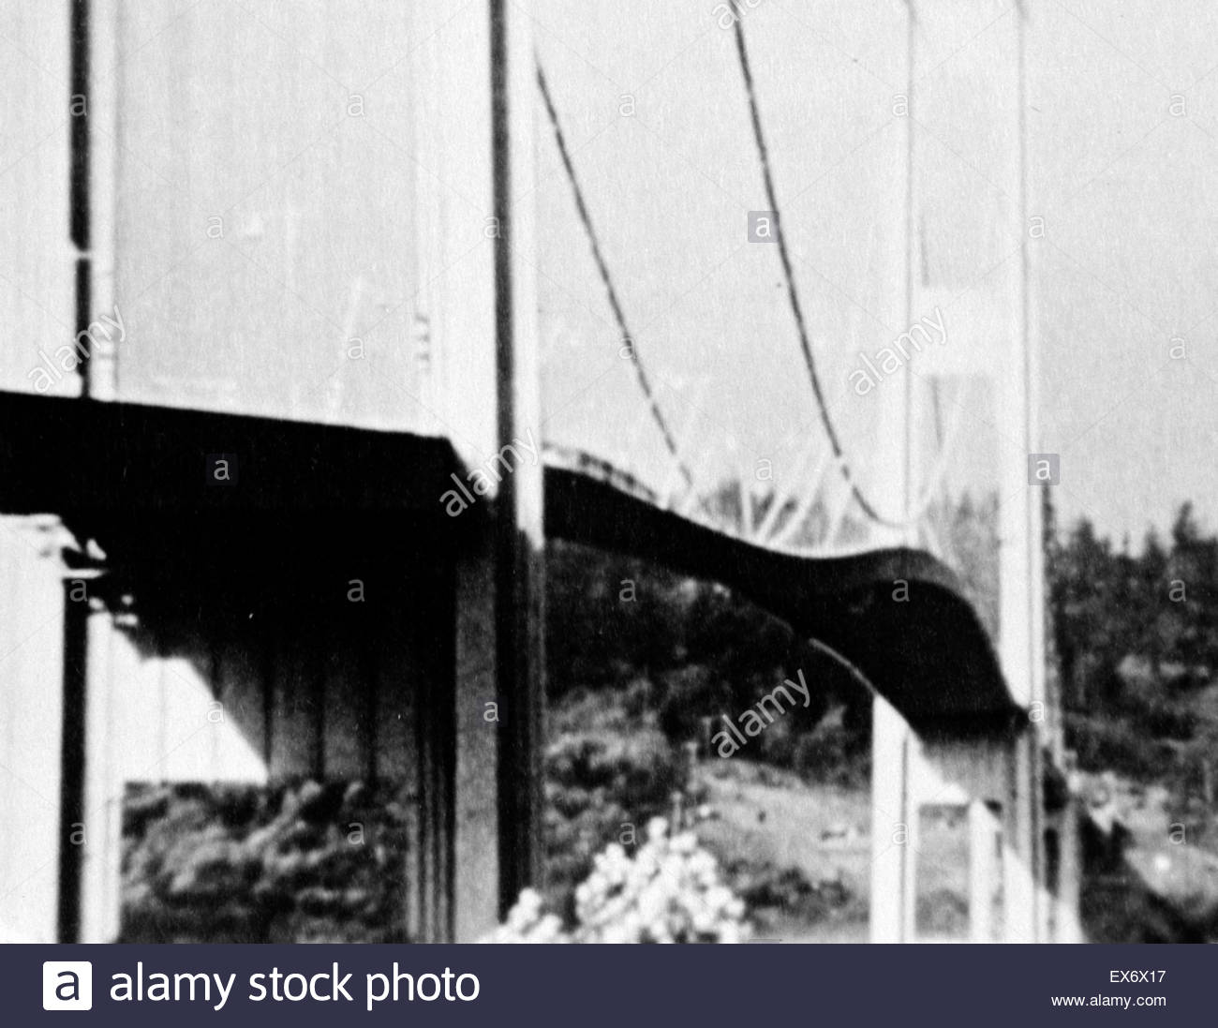
Tacoma Narrows Bridge, Washington
Figure: Fluttering effect
2.Flutter: Flutter is unstable oscillatory motion of a structure due to coupling between aerodynamic force and elastic deformation of the structure.
In case of classical flutter, energy is fed by wind counteracting the damping of the bridge. With the increase in the speed of incoming wind, the dumping of the structure increases.
Notes:
Figure: Fluttering effect

Slide 15

Effect of live load on bridge as impact load
impact load:
The dynamic effect caused due to vertical oscillation and periodical shifting of live load from one wheel to another is known as impact load.
According to AASTHO impact factor is expressed as a function of bridge span which is given below-
Impact Factor, I = $\frac{50}{(L+125)}$ ≤ 0.30
Here, L is the length in feet of the section of span that must be loaded to produce the maximum stress in a particular member.

Slide 16
Major characteristics of impact factor:
1. Impact factor increases as vehicle speed increases in most cases. 2. impact factor decreases as bridge span increases. 3.impact factor decreases as vehicle travel in more than one lane. 4.impact factor for exterior girder is much more larger than for interior girder due to the excided torsion mode shapes contribute to the dynamic response of exterior girder. 5.Under very good condition of the road surface roughness impact factor is well below that in design specifications.

Slide 17
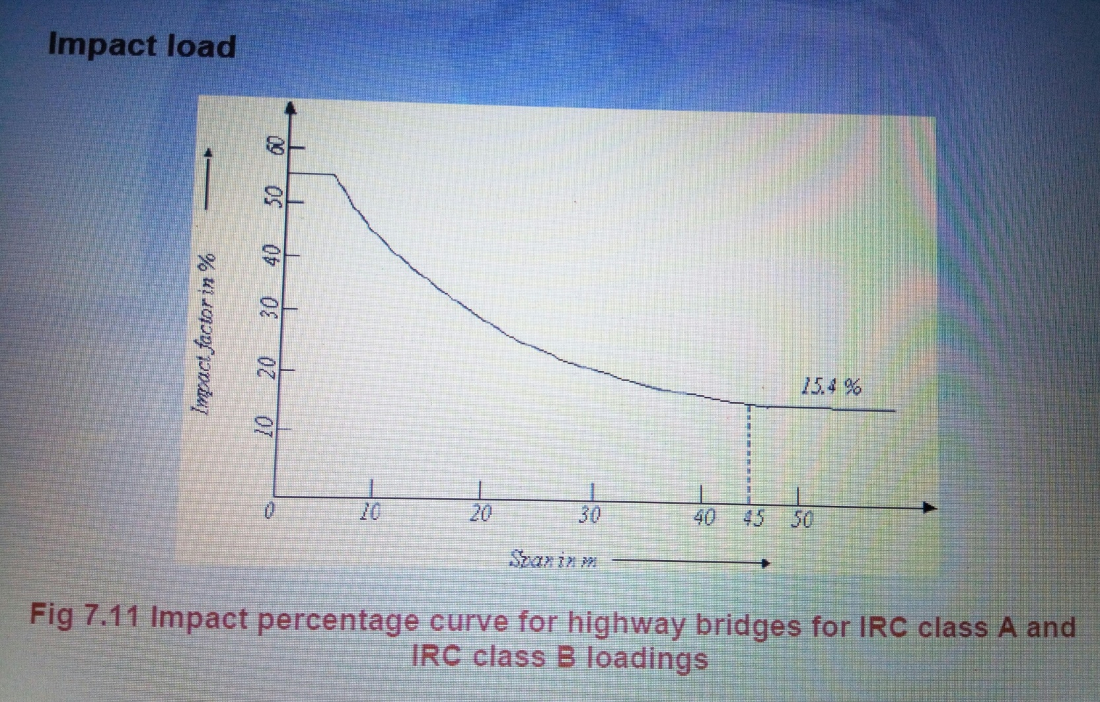
Impact percentage curve: Impact factors are specified by different authorities for different types of bridges. The following curve shows the relationship between impact factor and span of the bridge…

Slide 18
Impact factor for various limit state according to AASTHO
Limit state | Impact factor
Deck joint | 75%
Fracture limit state | 15%
All other limit state | 33%

Slide 19
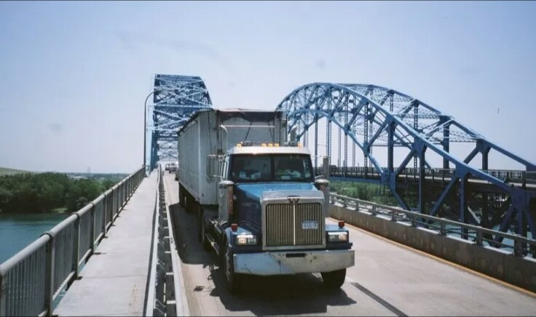
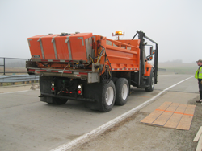
Effect of impact load
Vehicular live loads are multiplied with an impact factor to accommodate this dynamic effect in the design of bridge. The dynamic loads for moving vehicle are considered impact in bridge engineering because of relatively short duration.
Impact factor is considered for vibration induced by truck on bridge

Slide 20
Second segment
various types of construction methods all over the world

Slide 21
Bridge Construction Methods
Pre-cast
1. I Beams & Super Tee’s
2. Segmental
3. Full Span
ii. Cast in-situ
iii. Others

Slide 22
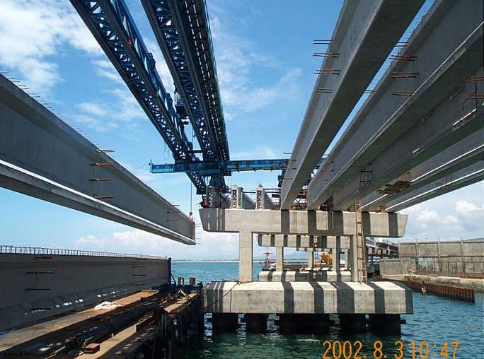
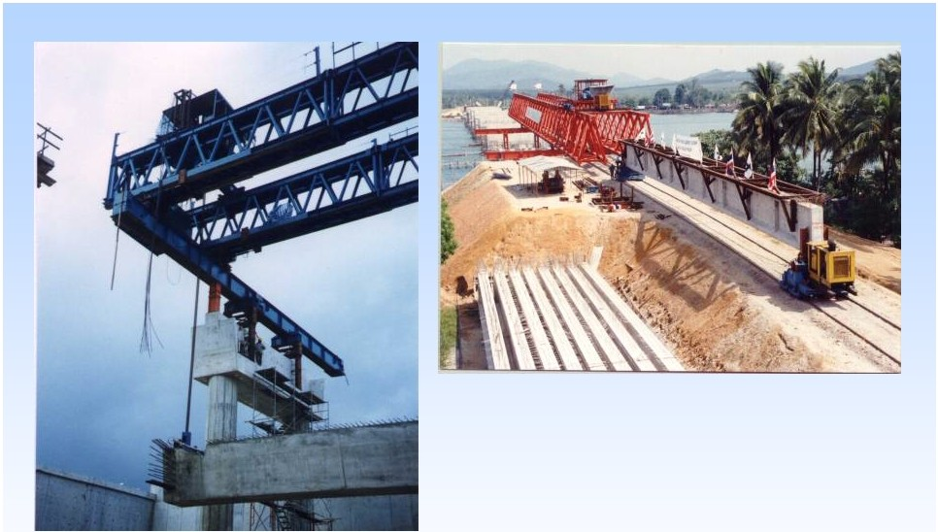
Precast I Beams & Super Tee’s
Cebu South Coastal Road -Philippines

Slide 23
Precast Segmental Techniques
1. Description
• Complete deck cast, delivered & erected in unique cells
• Segments are prestressed together using external and
or internal tendons. Joints can be “dry” or “wet”.
• Typically in Span by Span or Balanced Cantilever mode
2. Advantages
•Structurally efficient and aesthetic
•Complete with deck when erected I.e. rapid & safe
•Cast during substructure works – overlap of activities

Slide 24
PRECAST SEGMENTAL ERECTION TECHNIQUES
Erection on Falsework
Erection by Gantry
Erection by Crane
Erection by Lifting Frame
Full Span Erection Techniques

Slide 25
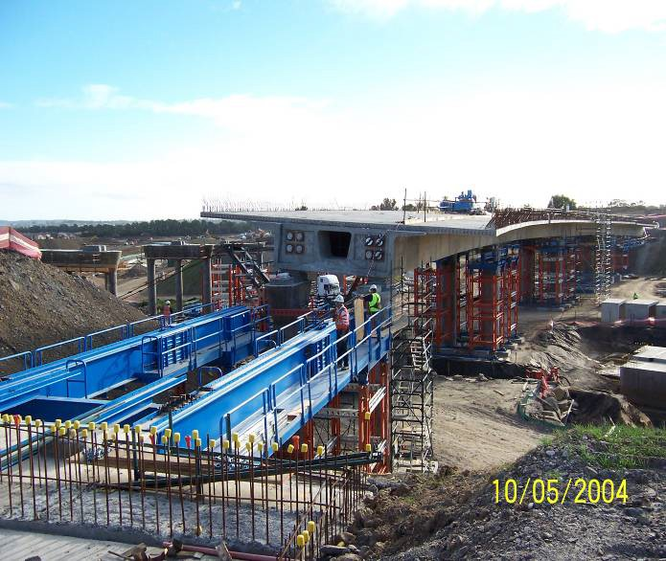
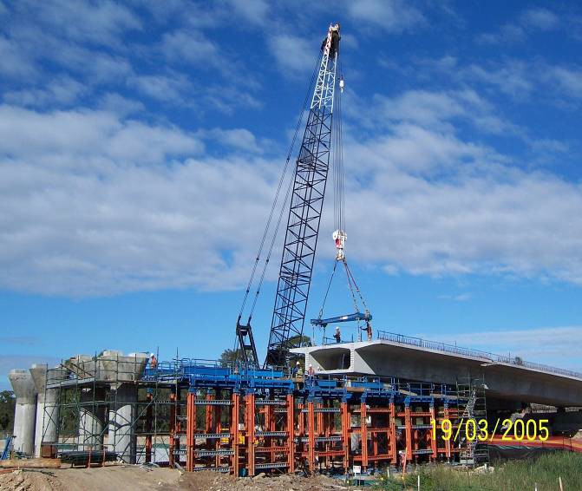
1. ERECTION ON FALSEWORK

Slide 26
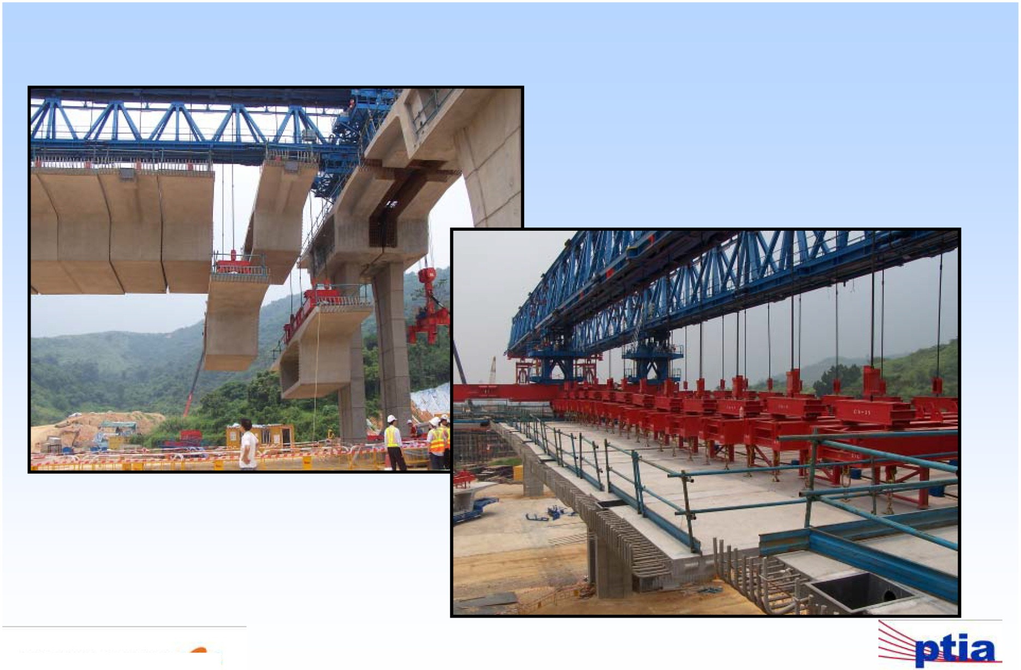
2. ERECTION BY GANTRY
A. Span By Span – “Simply Supported

Slide 27
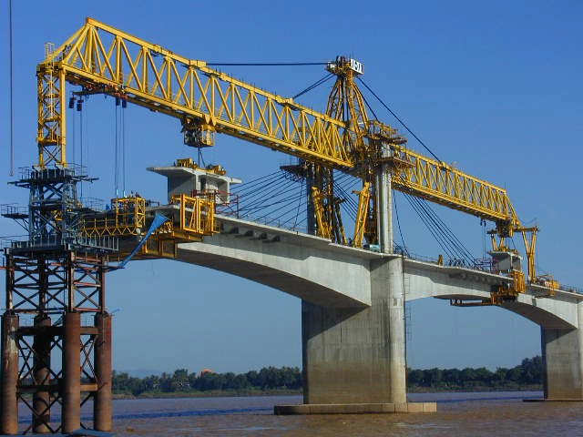
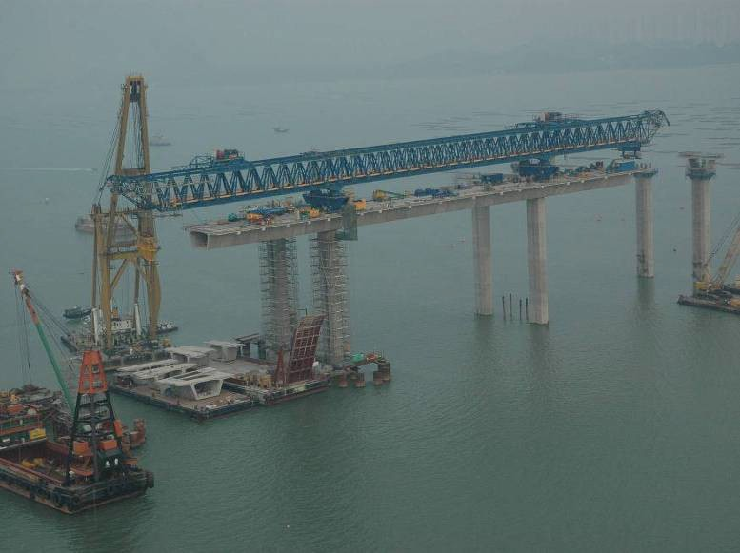
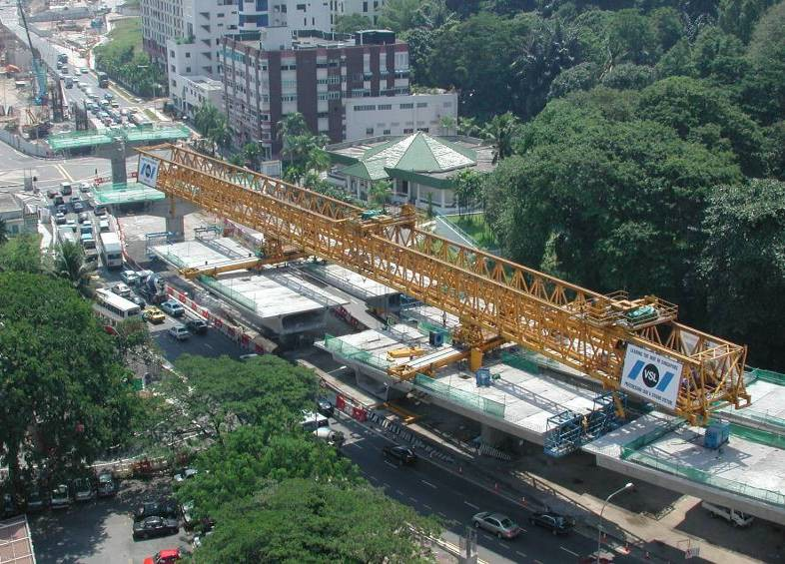
B. Balanced Cantilever

Slide 28
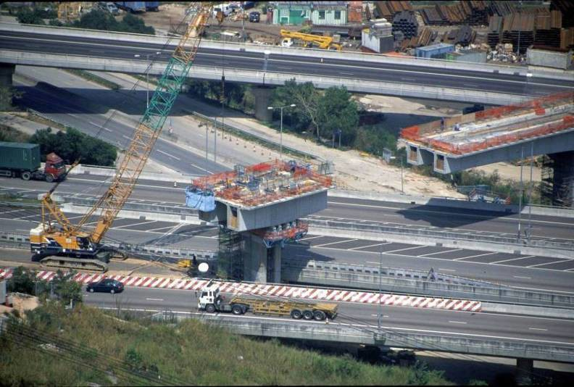
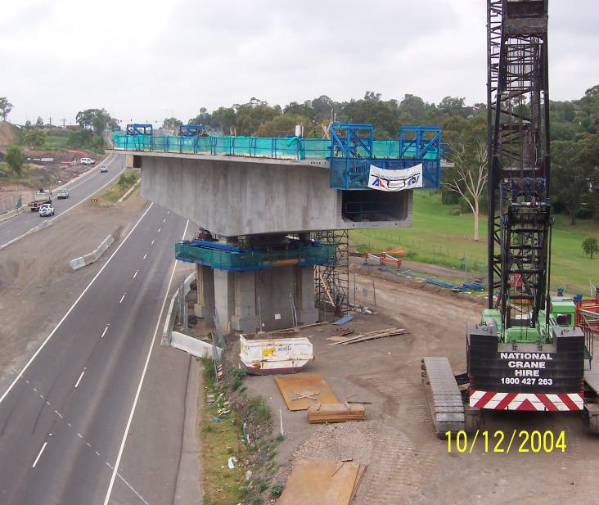
3. ERECTION BY CRANE

Slide 29
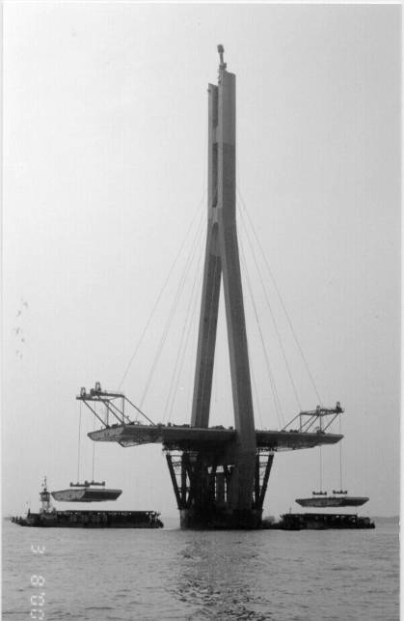
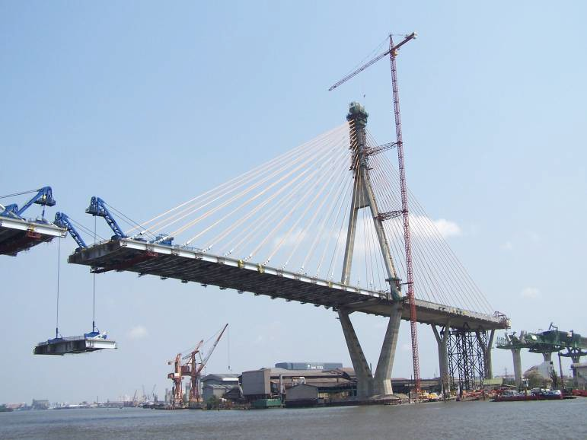
4. ERECTION BY LIFTING FRAME

Slide 30
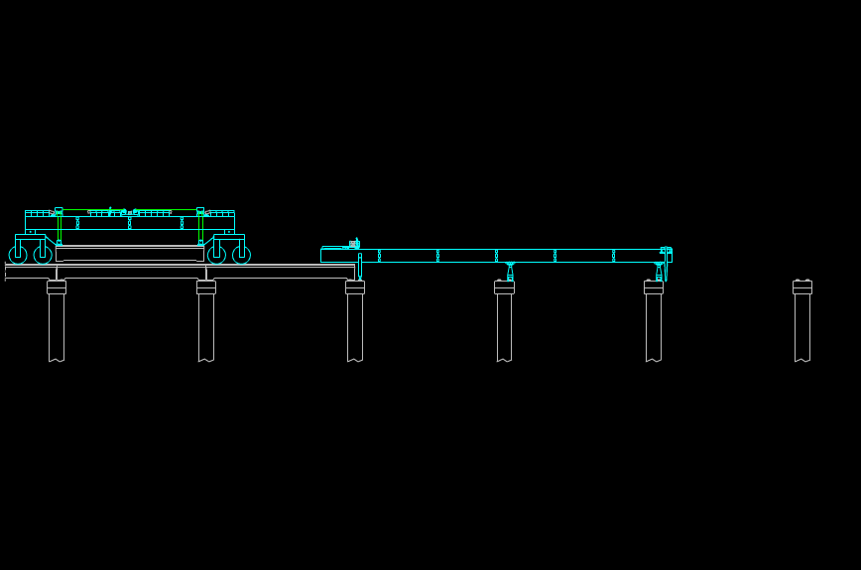
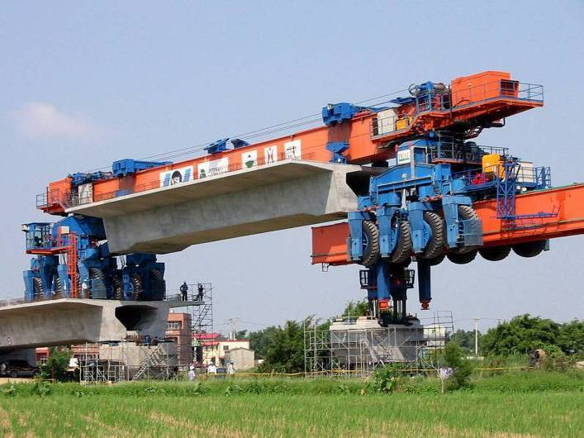
5. FULL SPAN PRECAST ERECTION TECHNIQUES

Slide 31
IN-SITU CONCRETE BRIDGES CONSTRUCTION TECHNIQUES.
1.Cast in-situ Post Tensioned
2.Balanced Cantilever
3.Incrementally Launched

Slide 32
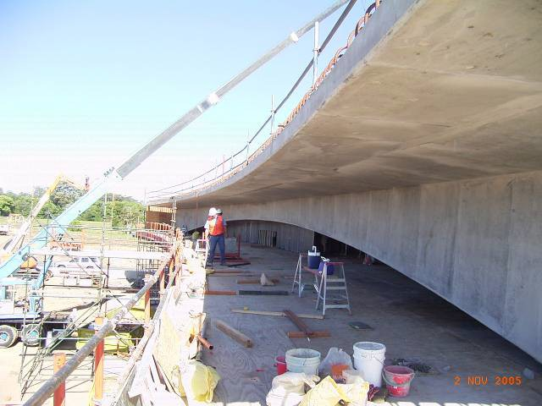
Cast in-situ Post tensioned

Slide 33
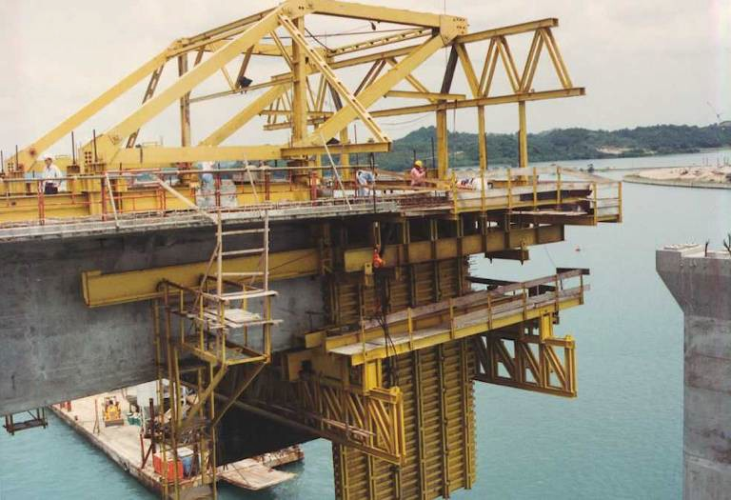
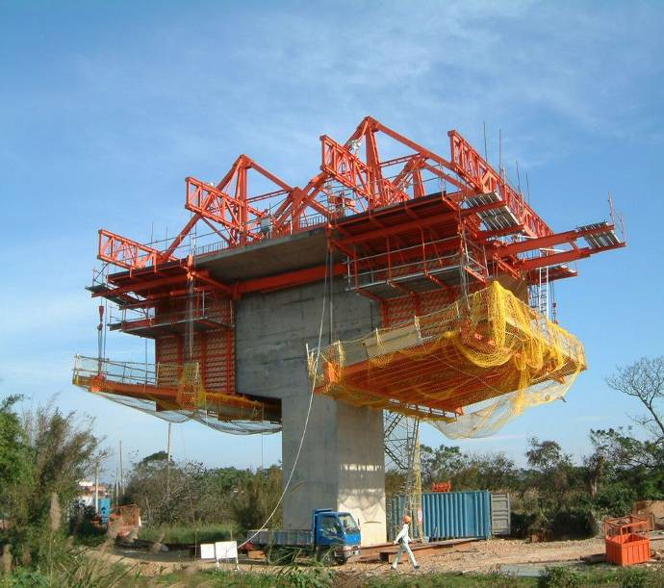
2. BALANCED CANTILEVER
Cast In-situ

Slide 34
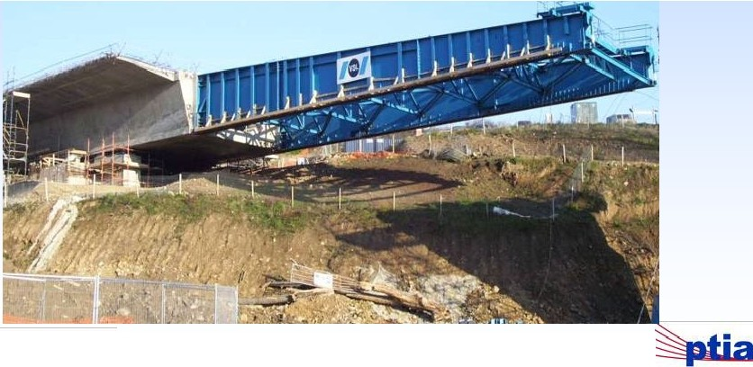
3. INCREMENTAL LAUNCHED Cast In-situ

Slide 35
Others
•glass bridge
•Pier Head Rotation
•Arch Lowering
•Main Span Lifting
•Skybridge

Slide 36
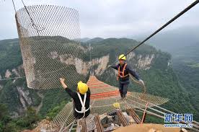
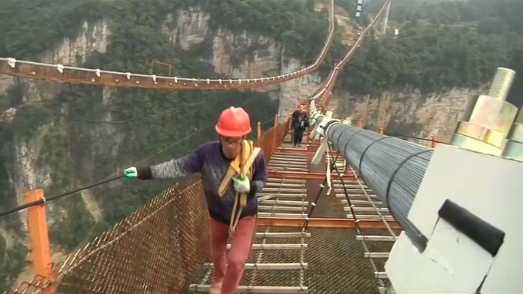
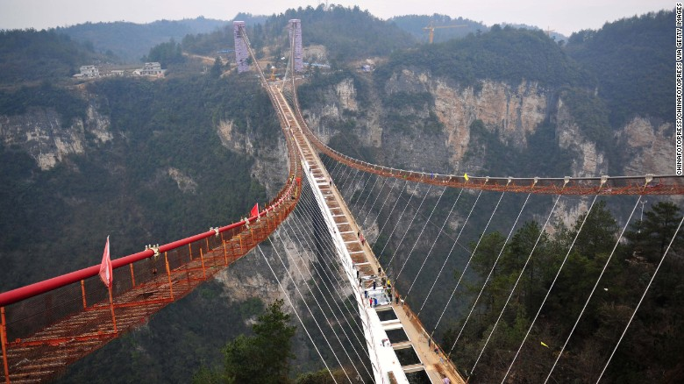
Glass bridge

Slide 37
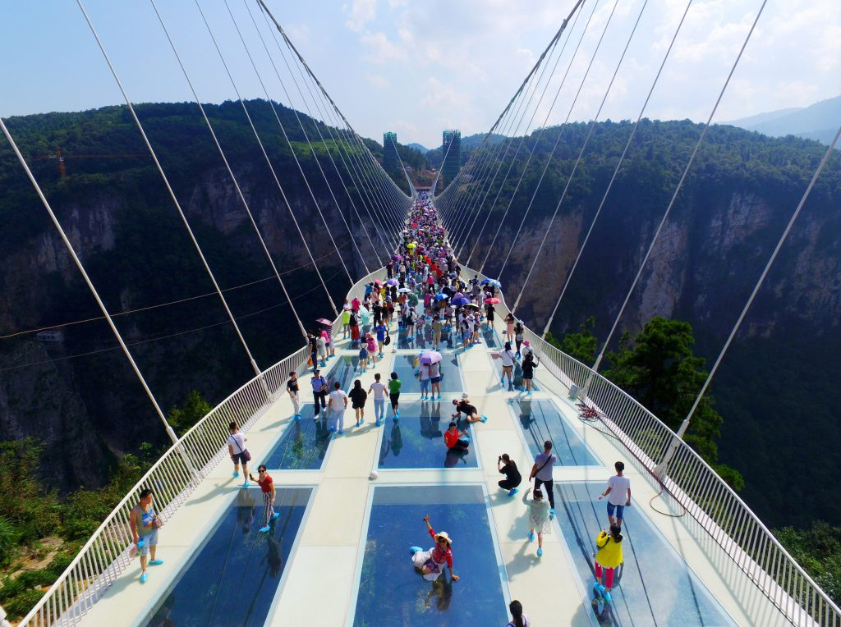
Some information about this glass bridge:
Location: Zhangjiajie Grand Canyon in Hunan’s picturesque, Zhangjiajie National Park,chaina
Construction duration: 2009-2016
Architect: Haim Dotan, Israel
Length: 1411ft
Height: 984ft
Carring capacity:800 people at a time

Slide 38
Thank you

