Slide 1
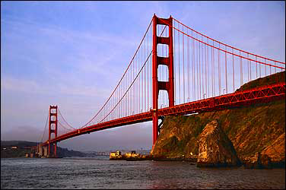
Presentation On Types of Bridge
Roll no-130041 to 130050

Slide 2
Bridge:
A bridge is a structure built to span physical obstacles such as a body of water, valley, or road, for the purpose of providing passage over the obstacle.
A bridge is a structure that is built over a river, road or railway to allow people and vehicles to cross from one side to the other.
Source: Google

Slide 3
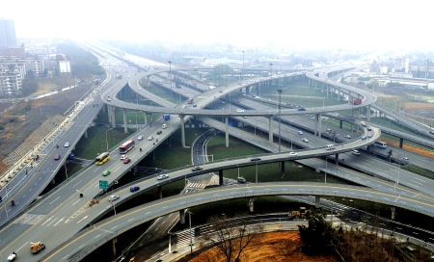
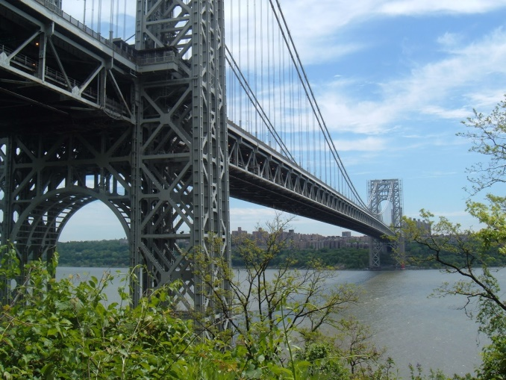
Why we will construct a bridge?
To reduce traffic and sub dividing network communication
To reduce collision at intersection point.
To connect two island

Slide 4
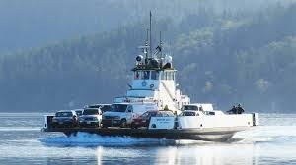
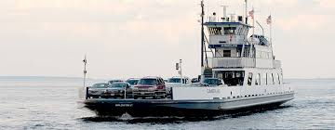
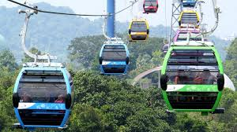
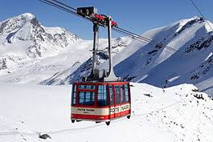
What may be the alternative option of bridge?
Fill by sand
Various types of water vehicles like boats, steamers, ferry boats, etc.
Cable car

Slide 5
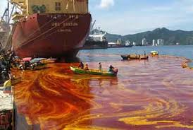
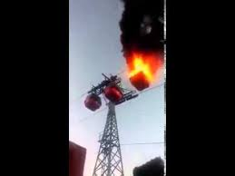
But why we will construct a bridge though it has alternative options?
Sand fill:-
For sand fill requires huge amount of sand and so cost will high .
Many harmful effect will arise on nature if we create a barrier in the natural flow of river.
Water vehicles:-
Time consuming.
Pollution of water due
to the emitting of waste
from ferry boats.
Cable car:-
Time consuming compare
to bridge transport.
Limitation of passenger.
If sudden accident occurs,
instant death of passenger will occur.

Slide 6

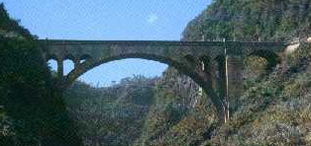
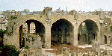
History of Bridge Development
Natural Bridges
700 A.D. Asia
Great Stone Bridge in China
Clapper Bridge
Tree trunk
Stone
Low Bridge
Shallow Arch
Strength of Materials
Mathematical Theories
Development of Metal
Roman Arch Bridge
The Arch
Natural Cement
Source: Google
1300 A.D. Renaissance
100 B.C. Romans

Slide 7
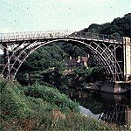
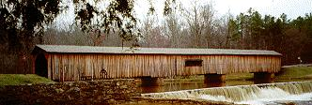
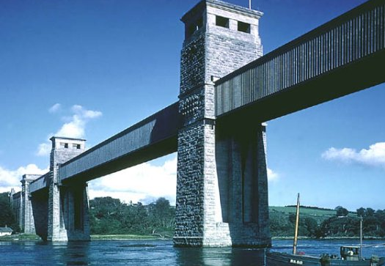

History of Bridge Development
1800 A.D.
1900 A.D.
Truss Bridges
First Cast-Iron Bridge
Coalbrookdale, England
Mechanics of Design
Britannia Tubular Bridge
Suspension Bridges
Use of Steel for the suspending cables
Wrought Iron
1850 A.D.
1920 A.D.
Source: Google

Slide 8
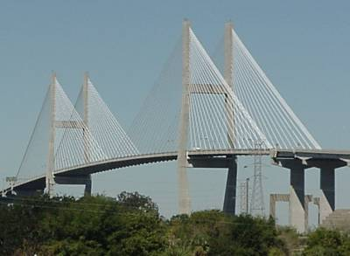
History of Bridge Development
2000 A.D.
Use of
Pre-stressed Concrete
Steel
Source: Google

Slide 9
What’s the factors that we should consider before construct a bridge?
Types of bridge
Soil conditions-for design of foundation
Ground conditions-for movement of machinery & materials
Height of bridge
Span length
Live loads
No of lanes of the bridge deck
Design life being considered
Grade of concrete
Seismic zone of the location
Budgeted cost of the bridge
Wind load
Local temperatures( Material expansion or contraction)
Visibility to boating and air traffic.
Source: Google

Slide 10
From Structural Point of View
SLAB
CABLE-STAYED
TYPES OF BRIDGES
BEAM
SUSPENSION
GIRDER
ARCH
TRUSS
Source: Google

Slide 11
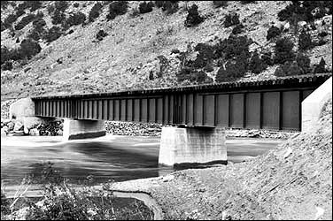

Types of Bridges
Beam bridge
Suspension bridge
Arch bridge
The type of bridge used depends on various features of the obstacle. The main feature that controls the bridge type is the size of the obstacle. How far is it from one side to the other? This is a major factor in determining what type of bridge to use.
The biggest difference between the three is the distances they can each cross in a single span.
Source: Google &
Wikipedia

Slide 12
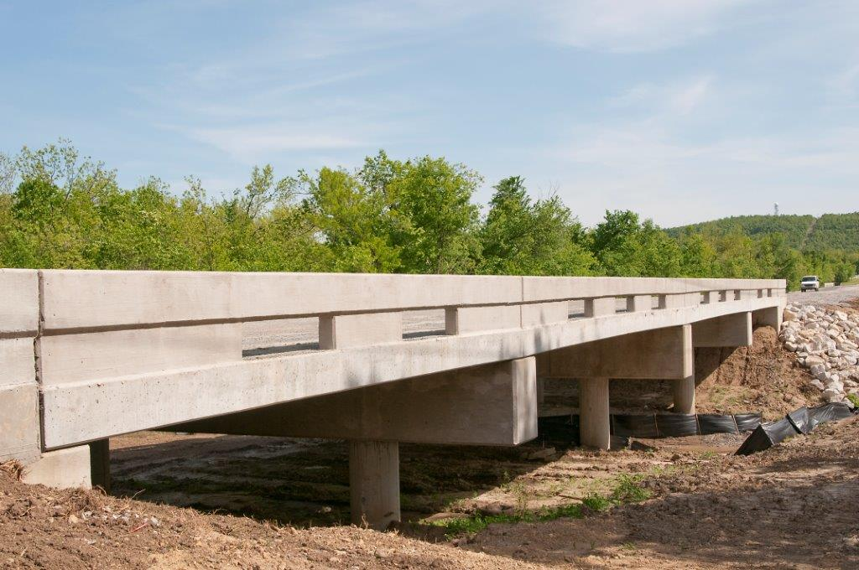
Slab Bridge
9 m span
Slab bridge is a short-span bridge consisting of a reinforced-concrete slab resting on abutments.
Source: Google &
Wikipedia

Slide 13
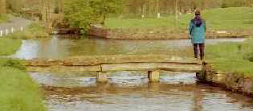

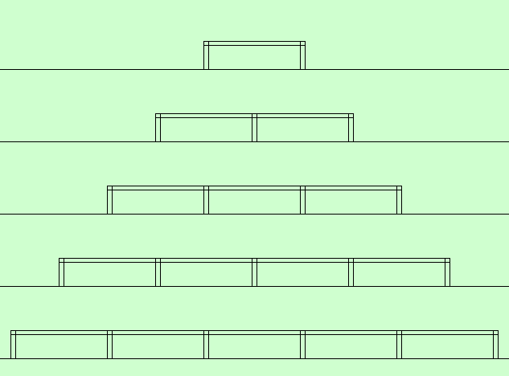
Types of Bridges
Beam Bridge
Consists of a horizontal beam supported at each end by piers. The weight of the beam pushes straight down on the piers. The farther apart its piers, the weaker the beam becomes. This is why beam bridges rarely span more than 250 feet.
Source: Google &
Wikipedia

Slide 14
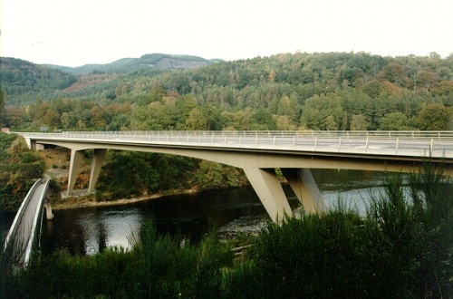
Girder Bridge
Generally span length varies between10m to 60 m.
A girder bridge, in general, is a bridge that uses girder as the means of supporting the deck. A bridge consists of three parts: the foundation (abutments and piers), the superstructure (girder, truss, or arch), and the deck. A girder bridge is very likely the most commonly built and utilized bridge in the world.
Source: Google &
Wikipedia

Slide 15
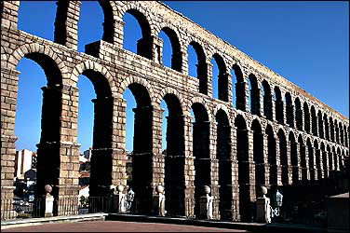
Types of Bridges
Arch Bridges
The arch has great natural strength. Thousands of years ago, Romans built arches out of stone. Today, most arch bridges are made of steel or concrete, and they can span up to 800 feet.
Small Spans (3 To 15m)
Steel Arch (519m)
Concrete Arches (305m)
Source: Google &
Wikipedia

Slide 16
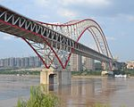
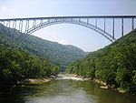
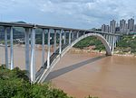
Photo | Name | Span Length(m) | Location
 | Chaotianmen Bridge | 552 | China
 | New River Gorge Bridge | 518 | USA
 | Wanxian Bridge | 420 | China
Source: Wikipedia

Slide 17
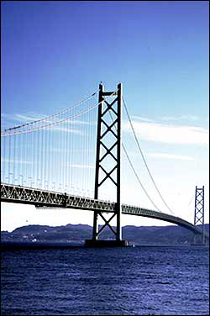
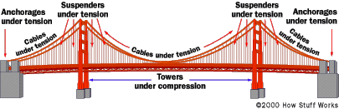
Types of Bridges
Suspension Bridges
This kind of bridges can span 2,000 to 7,000 feet -- way farther than any other type of bridge! Most suspension bridges have a truss system beneath the roadway to resist bending and twisting.
The cars push down on the roadway, but because the roadway is suspended, the cables transfer the load into compression in the two towers. The two towers support most of the bridge's weight.
Source: Google &
Wikipedia

Slide 18
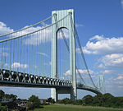

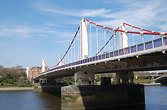
Photo | Name | Span Length(m) | Location
 | Verrazano–Narrows Bridge | 1,298 | USA
 | Hardanger Bridge | 1,310 | Norway
 | Chelsea Bridge | 213 | USA
Source: Wikipedia

Slide 19
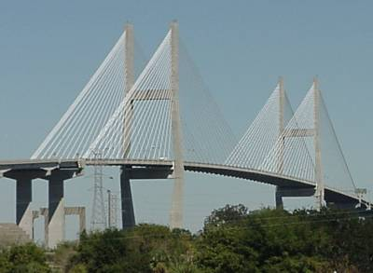
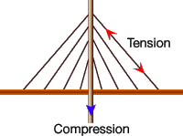
Types of Bridges
Cable-Stayed Bridge
The cable-stayed bridge, like the suspension bridge, supports the roadway with massive steel cables, but in a different way. The cables run directly from the roadway up to a tower, forming a unique "A" shape.
Cable-stayed bridges are becoming the most popular bridges for medium-length spans (between 500 and 3,000 feet).
Source: Wikipedia

Slide 20
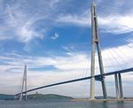
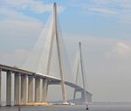
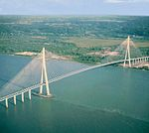
Photo | Name | Span Length(m) | Location
 | Russky Bridge | 1104 | Russia
 | Sutong Yangtze River Bridge | 1088 | China
 | Pont de Normandie | 856 | France
Source: Wikipedia

Slide 21
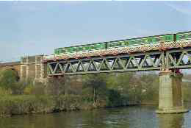
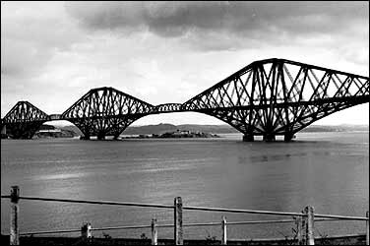
Types of Bridges
Truss Bridge
Simply supported (30 to 375m)
Cantilevered combination (550m)
All beams in a truss bridge are straight. Trusses are comprised of many small beams that together can support a large amount of weight and span great distances.
Source: Wikipedia

Slide 22
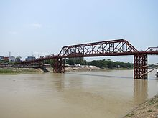
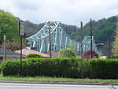

Photo | Name | Span Length(m) | Location
 | Keane Bridge | 350.52 | Sylhet, Bangladesh
 | Sewickley Bridge | 229 | Pennsylvania, USA
 | Hardinge Bridge | 1,798.32 | Paksey, Bnagladesh
Source: Wikipedia

Slide 23
Some list of bridge failure and their causes
Bridge | Location | Date | Reason | causalities | Damage
Rialto Bridge | Venice, Venetian Republic | 1444 | Overload by spectators during a wedding | Unknown | Bridge total damage
Eitai Bridge | Tokyo, Japan | 20 September 1807 | Overload by festival | 500–1500 killed | 1 pier and 2 spans destroyed
Ashtabula River Railroad Bridge | Ashtabula, USA | 29 December 1876 | Possible fatigue failure of cast iron elements | 92 killed, 64 injured | Bridge total damage
Sandö Bridge | Kramfors. Sweden | 31 August 1939 | Collapsed during construction | 18 killed | Complete loss of the main span
Source: Wikipedia

Slide 24
Some list of bridge failure and their causes
Bridge | Location | Date | Reason | causalities | Damage
Tarcoles Bridge | Orotina, Costa Rica | 22 October 2009 | Overload by heavy trucks and dead loads (water pipes). | 5 killed, 30 injured | Bridge total damage
Baihe Bridge | Beijing, China | 19 July 2011 | Bridge designed for max. 46 tonne vehicles, truck overloaded with 160 tons of sand caused it to collapse. | 0 Killed, 0 Injured | Entire 230m bridge destroyed.
I-85N Atlanta | Atlanta, USA | 30 March 2017 | Suspected arson caused PVC tubing stored under bridge to catch fire, critically weakening structure and causing collapse | 0 killed, 0 injured | Investigation pending as to fire cause.
Source: Wikipedia

Slide 25
Thank You
For your kind attention

