Slide 1
A Brief Study of Different Types of Bridges and Function of Components of a Simple Bridge
Prepared by-
Roll: 130084-99

Slide 2
What is Bridge?
A bridge is a structure providing a passage over an obstacle without closing the way underneath.
The required passage may be for a railway track, a road, pedestrians, a canal or pipeline.
The obstacle to be crossed may be a river, a road, railway or a valley.

Slide 3

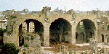
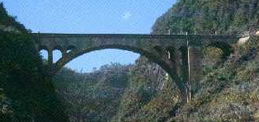
History of Bridge Development
100 B.C. Romans
2,104 years ago
700 A.D. Asia
1,304 years ago
Clapper Bridge
Tree trunk
Stone
Roman Arch Bridge
Arch design
evenly distributes
stresses
Natural concrete
made from mud
and straw
Great Stone Bridge in China
Low bridge
Shallow arch
Allows boats and water to
pass through

Slide 4
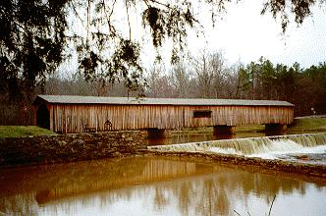

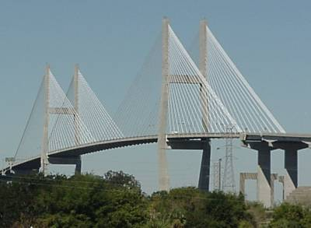
History of Bridge Development
1900
1920
Truss Bridges
Mechanics of Design
Wood
2000
Suspension Bridges
Use of steel in suspending cables
Prestressed Concrete
Steel

Slide 5
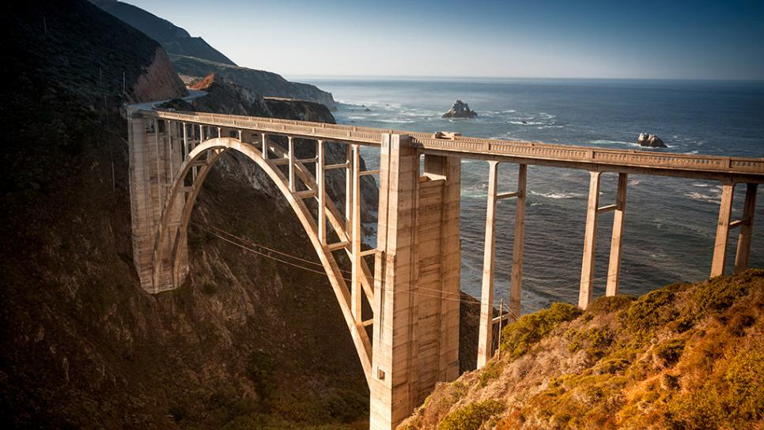
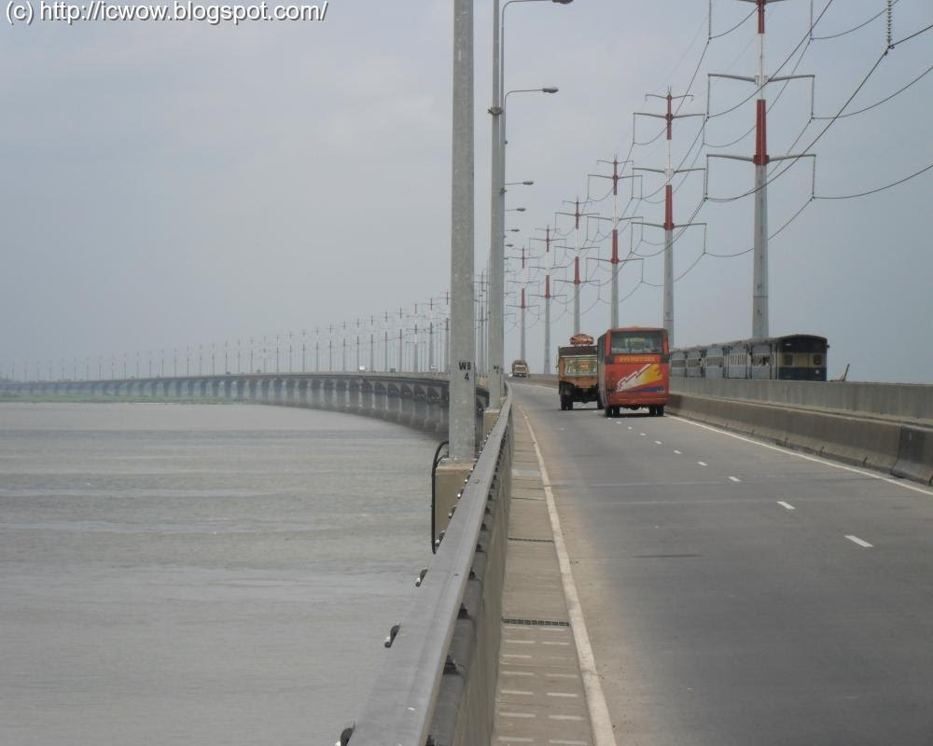
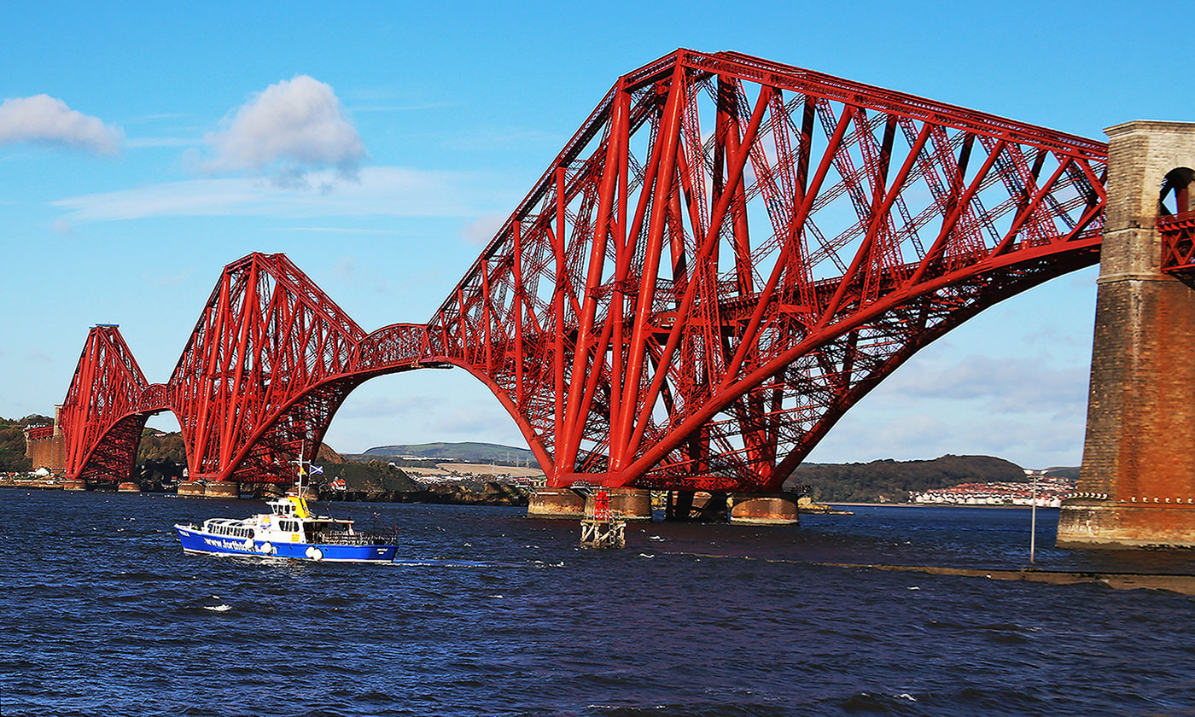
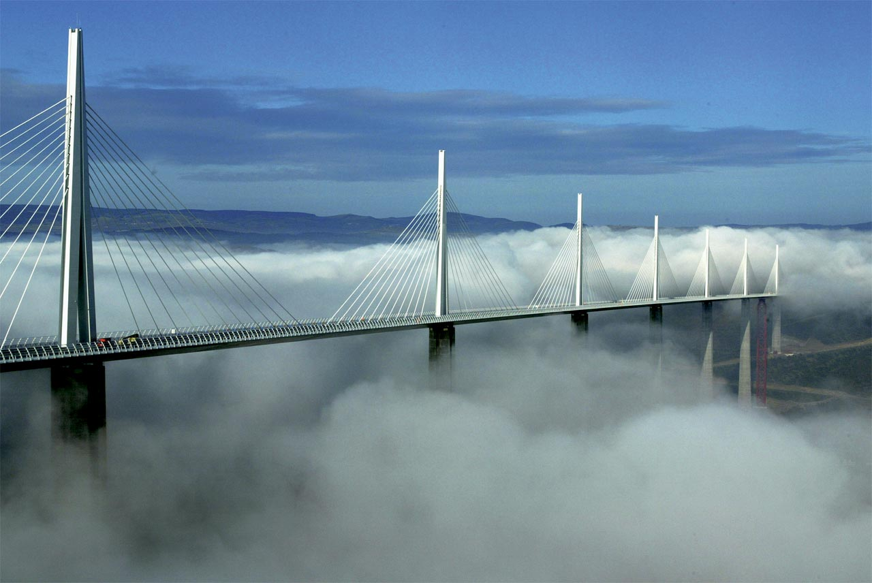
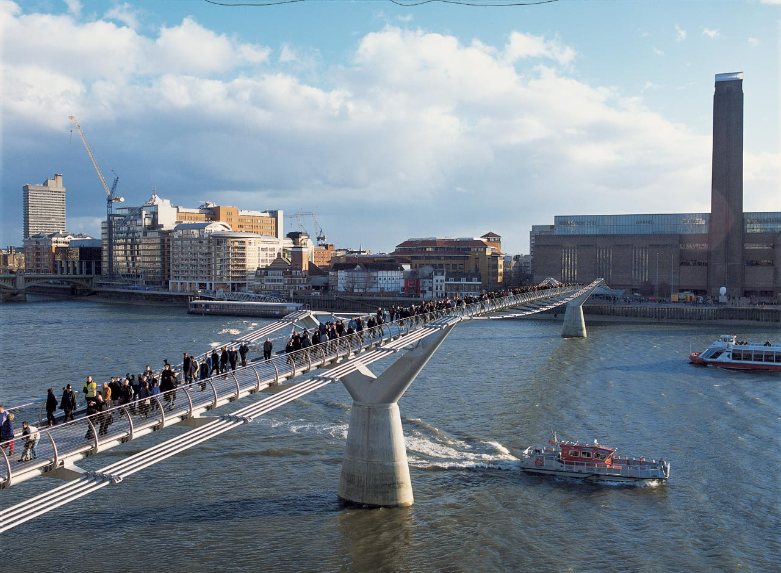
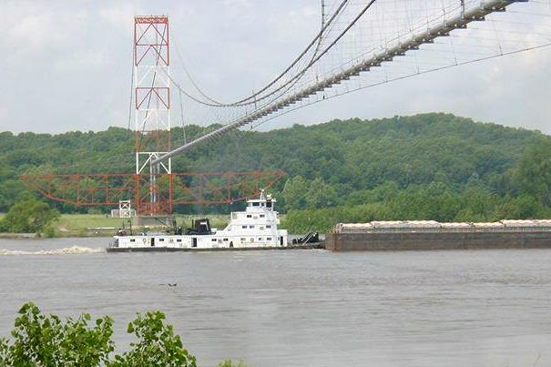
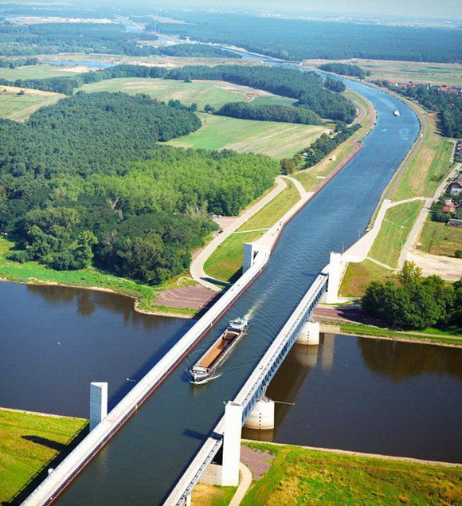
Types of bridges
Location:Bangabandhu Bridge
Total length‎: ‎5.63 km
Opened‎: ‎June 1998
Longest span‎: ‎100 m
Design‎: ‎rail and road bridge
According to Function
  Aqueduct bridge(canal over a river)
  Viaduct(road or railway over a valley or river)
  Pedestrian bridge
  Highway bridge
  Railway bridge
  Road-cum-rail or pipe line bridge
Location: Grand Tower Pipeline Bridge
Longest span: 2,162′
Design‎: ‎Pipeline bridge
Location: Millau Viaduct, southern France
Location: Bixby Creek Bridge, Big Sur coast of California
Location: London Millennium Footbridge
Location: Magdeburg Germany
Location: Forth Railway Bridge (1890) Scotland

Slide 6
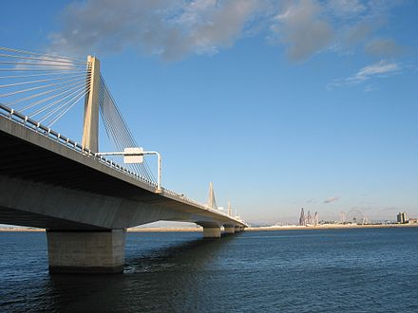
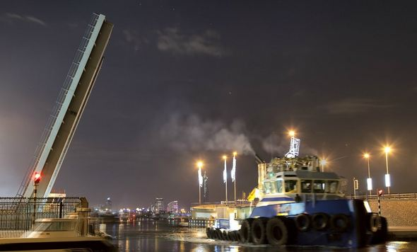
Types: According to Flexibility of Superstructure
Fixed Span Bridge
Movable Span Bridge
Ibigawa Bridge, Nagoya Japan
Al Maktoum Bridge, Dubai

Slide 7
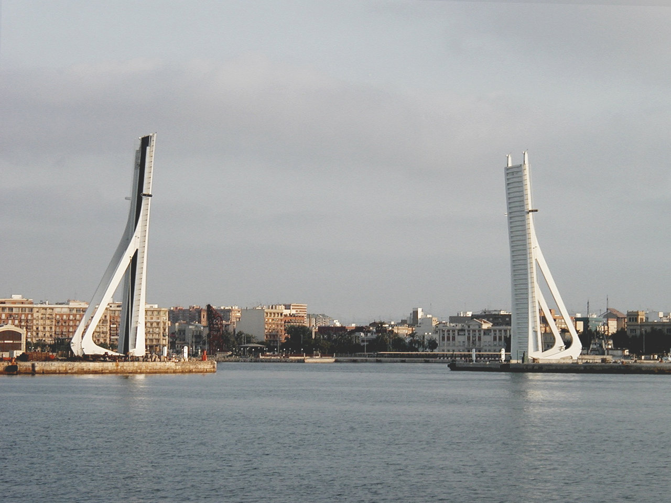
Types: According to Method of Clearance for Navigation
Movable – Bascule
  To enable ships to pass, one or two of the bridge's sections are raised and then lowered again.
  The emphasis is on causing as little interruption as possible to the flow of traffic both crossing and passing under the bridge
Largest Bascule Bridge in Europe
Rethe Klappbrücke, Hamburg

Slide 8
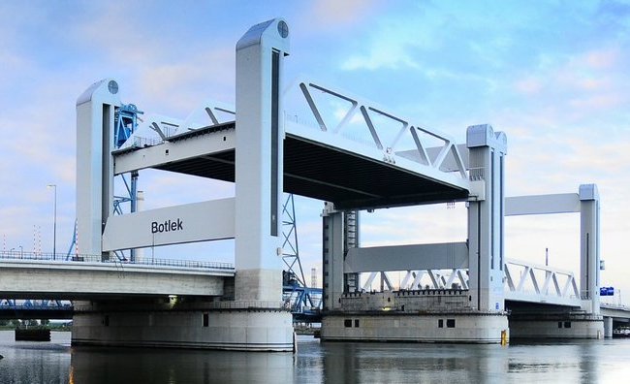
Types: According to Method of Clearance for Navigation
Movable – Lift bridge
  A bridge that can be raised vertically parallel with deck to allow boats or ships to pass beneath it.
Botlek bridge in Rotterdam, the Netherlands

Slide 9
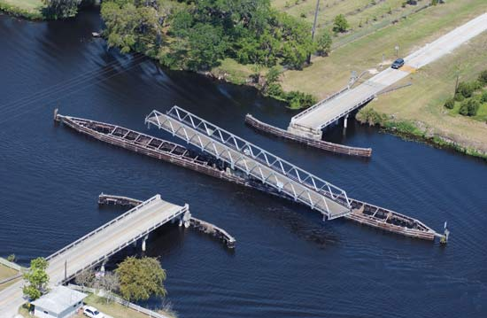
Types: According to Method of Clearance for Navigation
Movable – Swing Bridge
  A movable type of bridge over water that can be rotated horizontally to allow ships through.
  Its primary structural support a vertical locating pin and support ring, usually at or near to its centre of gravity, about which the turning span an rotate.
Fig. : Open swing bridge on Lake Okeechobee in Florida.

Slide 10
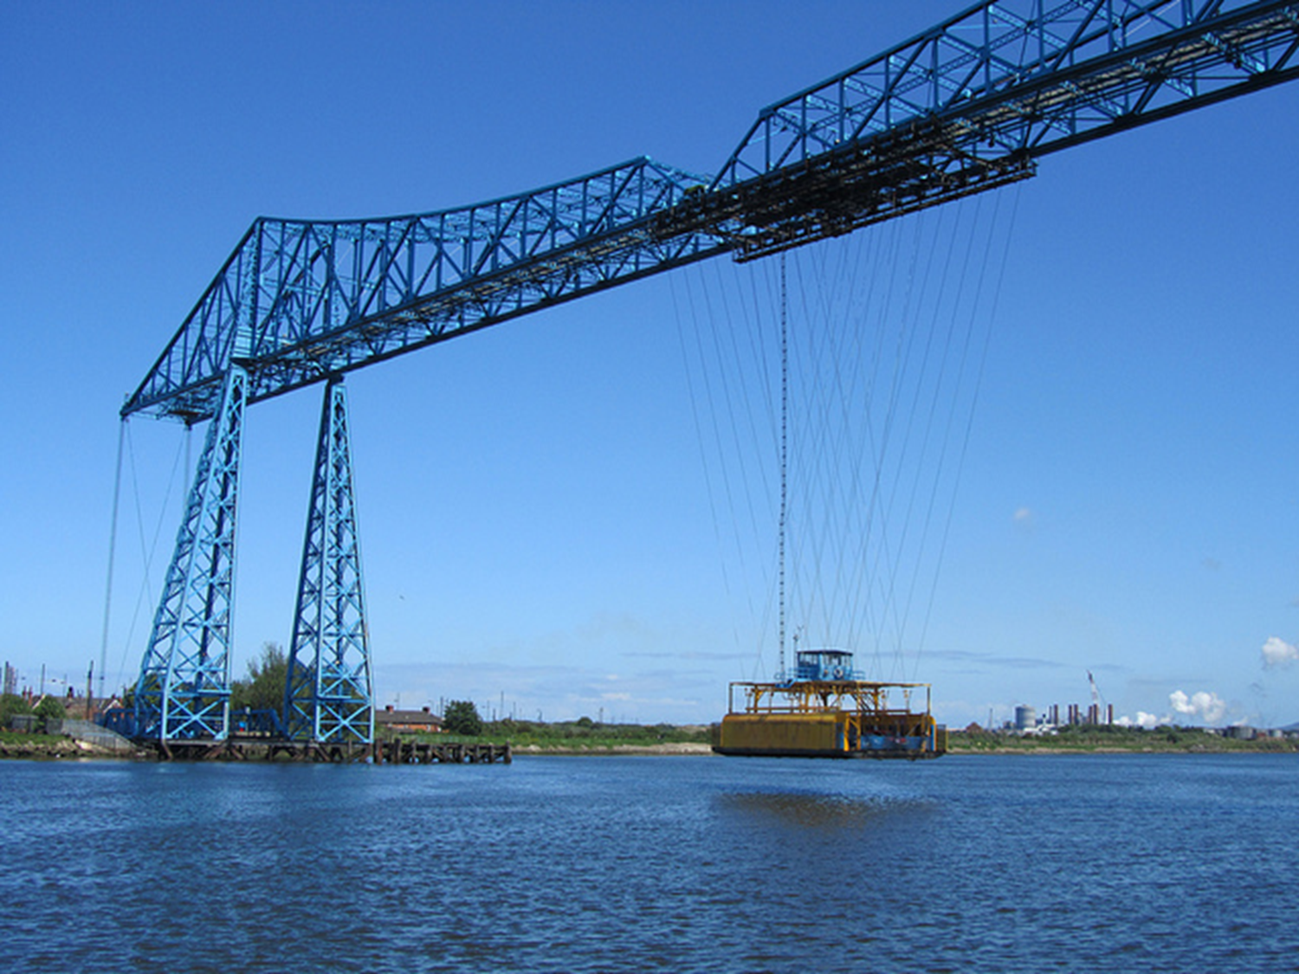
Types: According to Method of Clearance for Navigation
Transporter Bridge
  A transporter bridge (also ferry bridge or aerial transfer bridge) is a type of movable bridge that carries a segment of roadway across a river.
Transporter Bridge

Slide 11
According to Type of Super Structure
Girder/Beam Bridge
Truss Bridge
Rigid Frame Bridge
Arch Bridge
Cable Stayed Bridge
Suspension Bridge

Slide 12
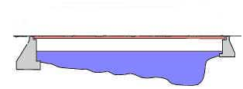
Girder/Beam Bridge
The most common and basic type
Typical spans : 10m to 200m

Slide 13
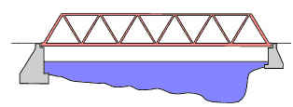
Truss Bridge
Truss is a simple skeletal structure.
Typical span lengths are 40m to 500m.

Slide 14
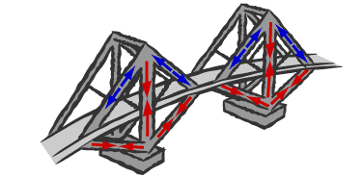
Forces in a Truss Bridge
In design theory, the individual members of a simple truss are only subject to tension and compression and not bending forces. For most part, all the beams in a truss bridge are straight.

Slide 15
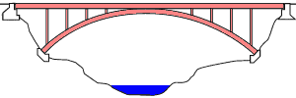
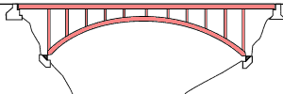
Arch Bridges
Arches used a curved structure which provides a high resistance to bending forces.
Both ends are fixed in the horizontal direction (no horizontal movement allowed in the bearings).
Arches can only be used where ground is solid and stable.
Hingeless arch is very stiff and suffers less deflection.
Two-hinged arch uses hinged bearings which allow rotation and most commonly used for steel arches and very economical design.
Hinge-less Arch
Two hinged Arch

Slide 16
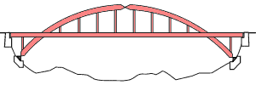
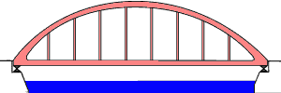
Arch Bridges
The three-hinged arch adds an additional hinge at the top and suffers very little movement in either foundation, but experiences more deflection. Rarely used.
The tied arch allows construction even if the ground is not solid enough to deal with horizontal forces.
Three-hinged Arch
Tied Arch

Slide 17
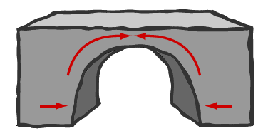
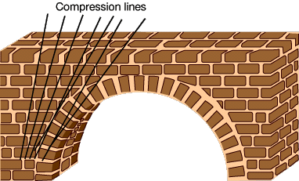
Forces in an Arch
Arches are well suited to the use of stone because they are subject to compression.
Many ancient and well-known examples of stone arches still stand to this today.

Slide 18

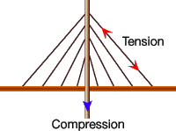
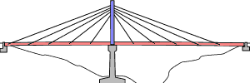
Cable Stayed
A typical cable-stayed bridge is a continuous deck with one or more towers erected above piers in the middle of the span.
Cables stretch down diagonally from the towers and support the deck. Typical spans 110m to 480m.

Slide 19
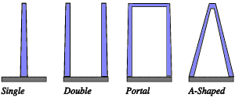
Cable Stay Towers
Cable stayed bridges may be classified by the number of spans, number and type of towers, deck type, number and arrangement of cables.

Slide 20
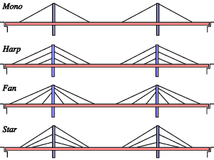
Cable Stay Arrangements

Slide 21
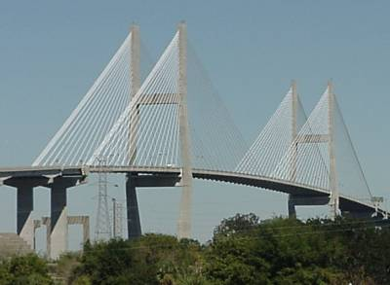

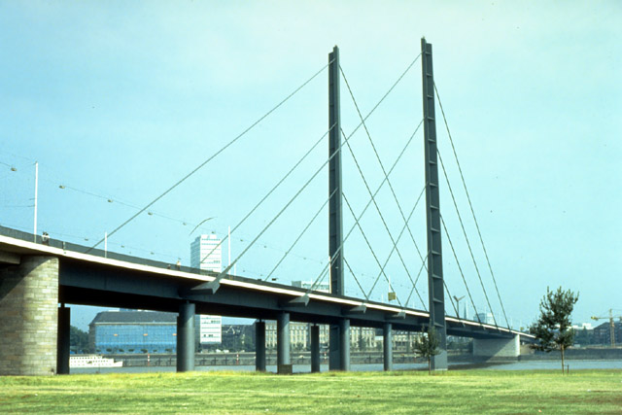
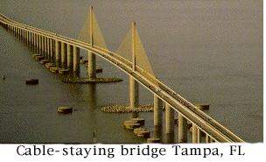
Cable Stayed Bridges

Slide 22
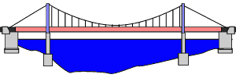
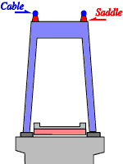
Suspension Bridge
A typical suspension bridge is a continuous deck with one or more towers erected above piers in the middle of span. The deck maybe of truss or box girder.
Cables pass over the saddle which allows free sliding.
At both ends large anchors are placed to hold the ends of the cables.

Slide 23
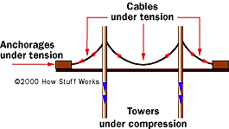
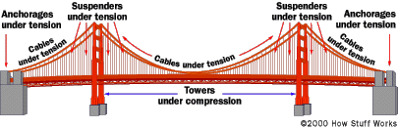
Forces in Suspension Bridge

Slide 24
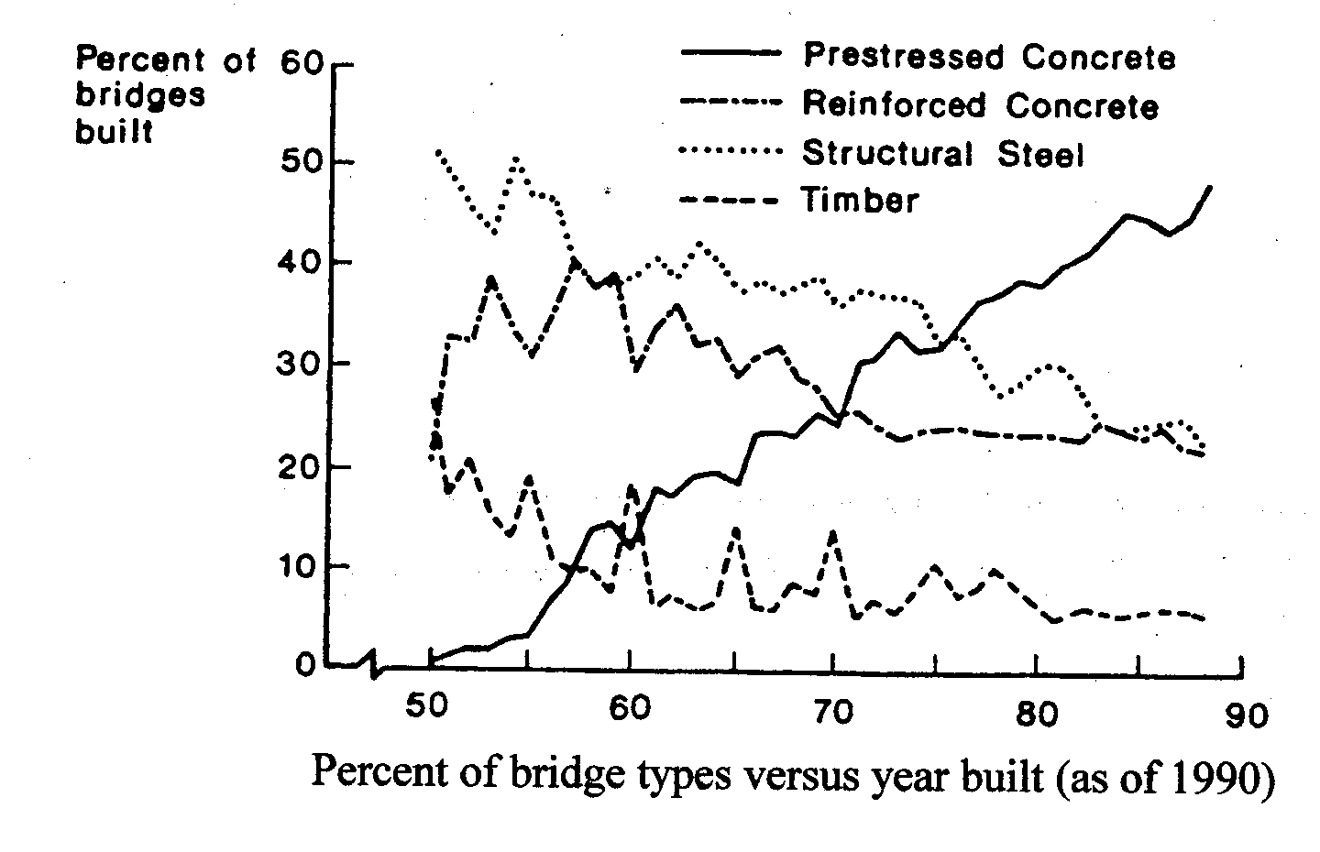
Types : According to Materials for Construction
Reinforced Concrete.
Prestressed Concrete.
Steel.
Composite.
Timber.
Fig. : Curve based on materials used for construction

Slide 25
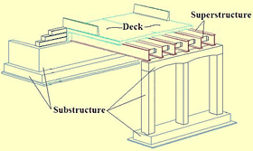
Study of Components of Simple Bridge
During the design process, every bridge can be divided broadly into three parts.
Superstructure
  Superstructure that part of the structure which supports traffic and includes deck, slab and girders. All the parts of the bridge which is mounted on a supporting system can be classified as a Super structure
Substructure
  Substructure that part of the structure, i.e. piers and abutments, which supports the superstructure and which transfers the structural load to the foundations.
Foundation
  Foundation is the component which transfers loads from the substructure to the bearing strata. Depending on the geotechnical properties of the bearing strata, shallow or deep foundations are adopted. Usually, piles and well foundations are adopted for bridge foundations

Slide 26
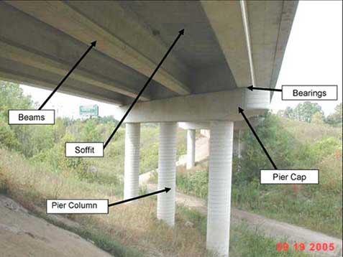
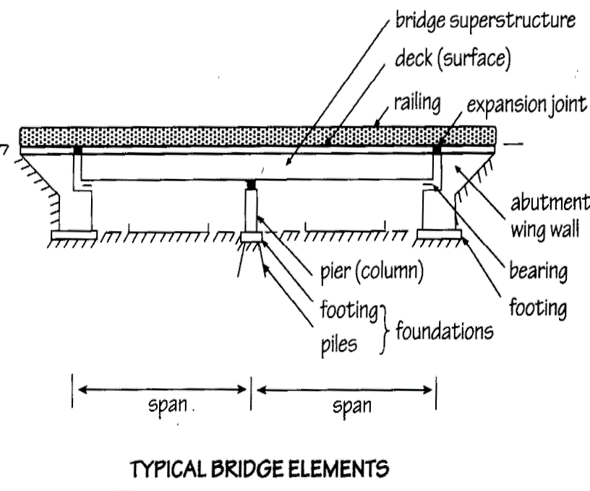
Bridge Elements

Slide 27
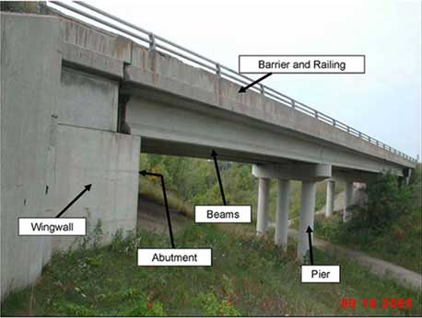

Slide 28
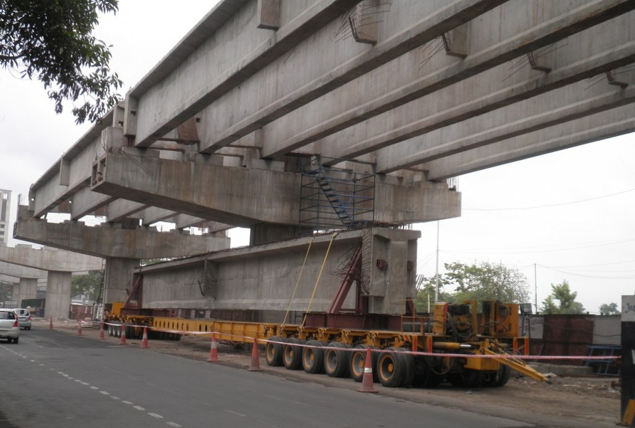
Major Parts of a RC Bridge
A RC bridge has 5 Major Parts.
Beam / Girder
  Beam or girder is that part of superstructure structure which is under bending along the span. it is the load bearing member which supports the deck. Span is the distance between points of support (e.g. piers, abutment). Deck is bridge floor directly carrying traffic loads. Deck transfers loads to the Girders depending on the decking material.
Prestressed girders

Slide 29
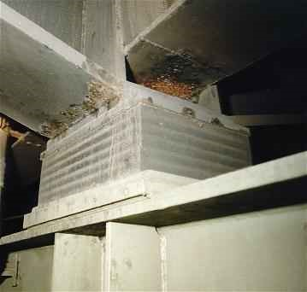
Major Parts of a RC Bridge
Bearing
  transfers loads from the girders to the pier caps. Bearing is a component which supports part of the bridge and which transmits forces from that part to another part of the structure whilst permitting angular and/or linear movement between parts.
Laminated Elastomeric Bearings

Slide 30
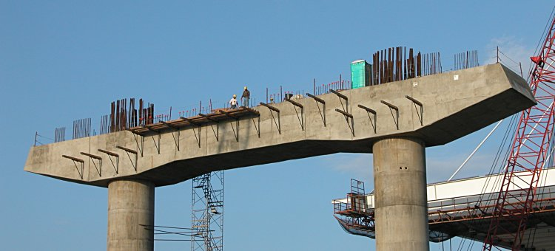
Major Parts of a RC Bridge
Pier Cap / Headstock
  Pier Cap / Headstock is the component which transfers loads from the superstructure to the piers. Pier cap provide sufficient seating for the Bridge girders and disperse the loads from the bearings to the Piers.
RC Pier Cap

Slide 31
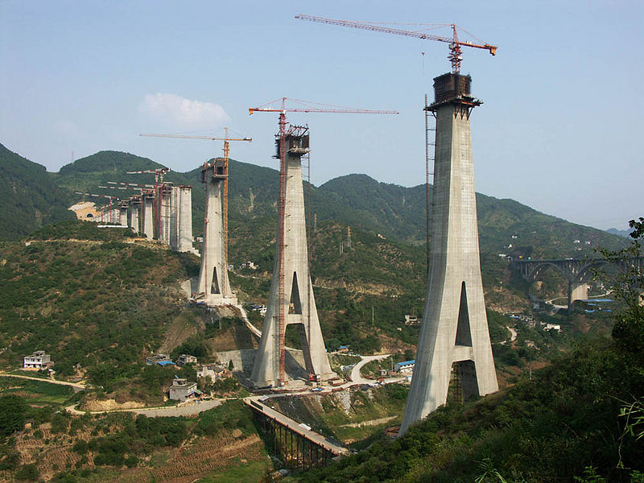
Major Parts of a RC Bridge
Pier
  Pier is that part of a part of the substructure which supports the superstructure at the end of the span and which transfers loads on the superstructure to the foundations.
  Depending up on aesthetics, site, space and economic constraints various shapes of piers are adopted to suit to the requirement.
  Mostly Reinforced Concrete or Prestressed concrete are adopted for the construction of piers.
  Piers are compression members. Depending on the loading and bearing articulations, piers may be subjected to bending as well
Bridge Pier Substructure

Slide 32
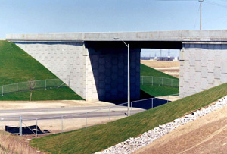
Wing Wall
These are provided as extension of the abutments to retain the earth of approach bank which otherwise has a natural angle of repose.
Wing wall

Slide 33
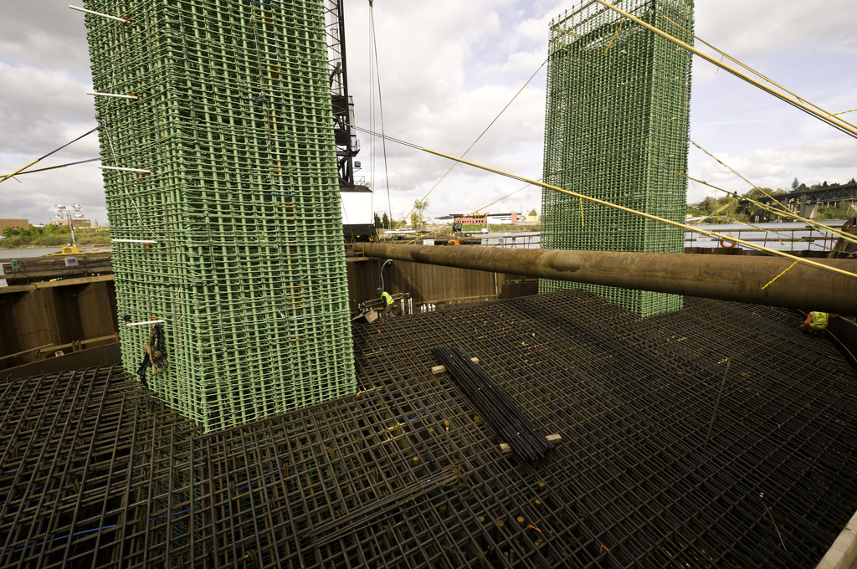
Major Parts of a RC Bridge
Pile cap and Piles
  Pile foundation is the most commonly used foundation system for bridges.
  Pile is a slender compression member driven into or formed in the ground to resist loads.
  A reinforced concrete mass cast around the head of a group of piles to ensure they act together and distribute the load among them it is known as pile cap.
Completed pile cap rebar framing

